Slide 1
Community Led Housing in East Suffolk
Stephanie Baxter MA, CIHCM
Stephanie.baxter@eastsuffolk.gov.uk
07880 105 421
Notes:
Good Morning everyone and thank you for this opportunity to speak to you today about East Suffolk Council’s work with community led housing groups. My name is Stephanie Baxter and I am the Housing Enabling Manager.

Slide 2










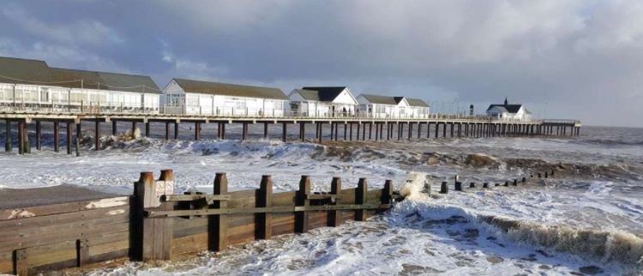

East Suffolk in context
Notes:
Who and where are we? We are on most easterly part of England and a combination of the Former Waveney and Former Suffolk Coastal councils to become East Suffolk last year. We are a rural district with strong agricultural sector, a coastline with beaches and shipping lanes, together with our own nuclear power station and energy sector. We have a strong economy with good skills but areas of deprivation, high house prices and countryside to protect.

Slide 3
The Housing Problem - Affordability
40% earn less than
£19,699
(East Suffolk)*
60% earn less than
£27,392
(East Suffolk)*
Median income
£23,277
(East Suffolk)*
Residents need 8 X income = median priced home
Source
Average income
£28,472
(East Suffolk)*
*Source:
Table 8.7a
Notes:
60% earn less than £28k

Slide 4
The Housing Problem - costs
Property Type | Average price*
Detached | £307,932
Semi Detached | £204,344
Terraced | £210,995
Flat | £163,350
*Based on data from Home.co.uk
Terraced properties need joint income of £51,242 plus £31,649 deposit (15%)
Flatted properties need joint income of £39,670 plus £24,502 deposit (15%)
Notes:
A flat will need £24k deposit and an income of almost £40k

Slide 5
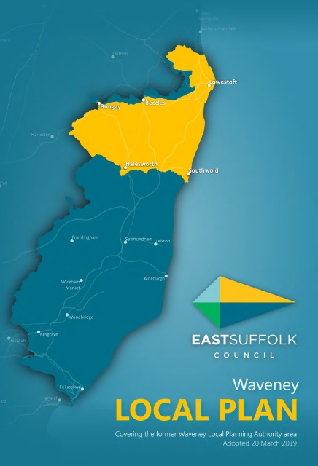
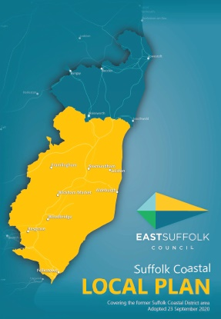

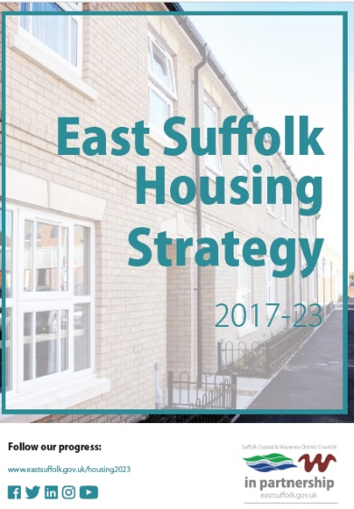

Proactive policy approach
Strategic Plan:- Enabling Communities … ‘enhance the place we live & work for the wellbeing of all’
Waveney LP :– CLH with Self Build (8.20)
Housing Strategy - promoting delivery & investigate alternative models of delivery in regeneration schemes
Suffolk Coastal LP :– CLT’s in Neighbour-
hood plans & CLH initiatives including Self Build to deliver housing (5.49/5.54)
Rural Exception Site policy in both LP’s
Enabling Strategy:-Promote, support, guide and enable Neighbourhood Plan & community groups to deliver housing and community assets as required.
Appointed lead officer
Notes:
East Suffolk has a very proactive approach. It is district of two halves, both now with adopted local plan. The Councils strategic plan has an ‘enabling communities’ as one of its themes. Within this is says “to enhance the place we live and work for the wellbeing of all”. This value runs through all the strategies before you. The district is covered by two local plans with supportive policies in both. These include options for people who wish to build their own home. Whilst Neighbourhood plans are encouraged to consider how community land trusts deliver housing and other infrastructure as communities identify. In addition, the housing strategy and the Housing Enabling strategy provide a greater emphasis and guidance to deliver these outcomes.

Slide 6

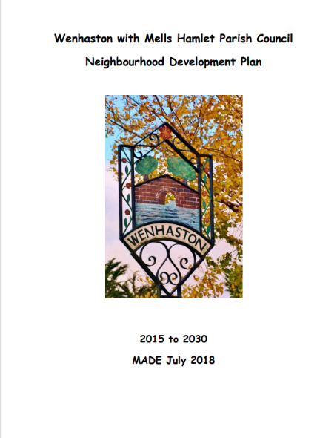
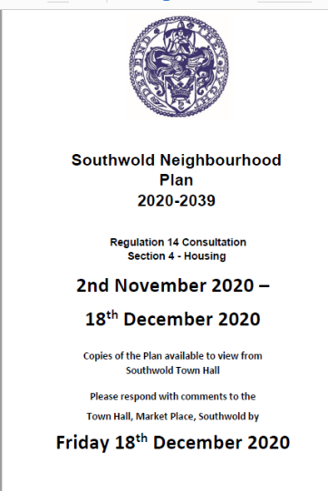
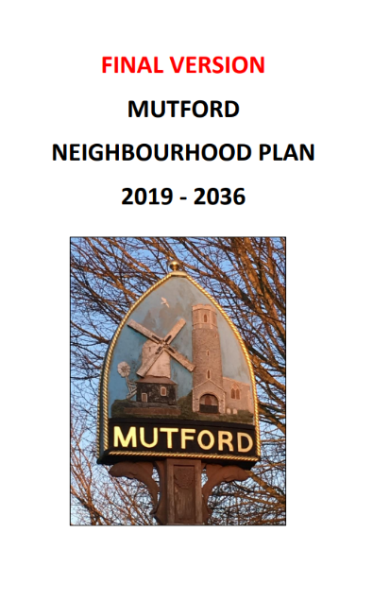
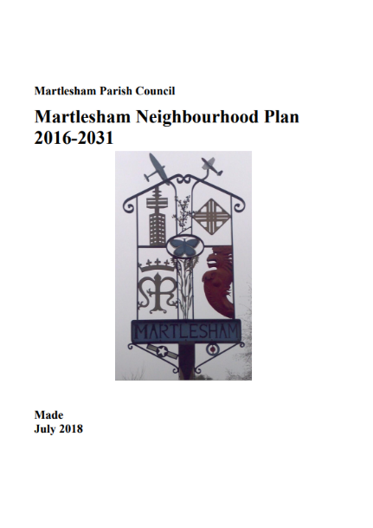
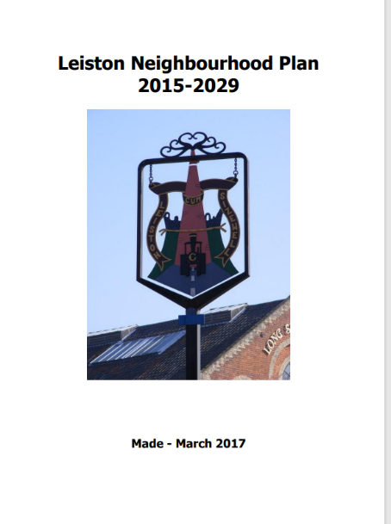
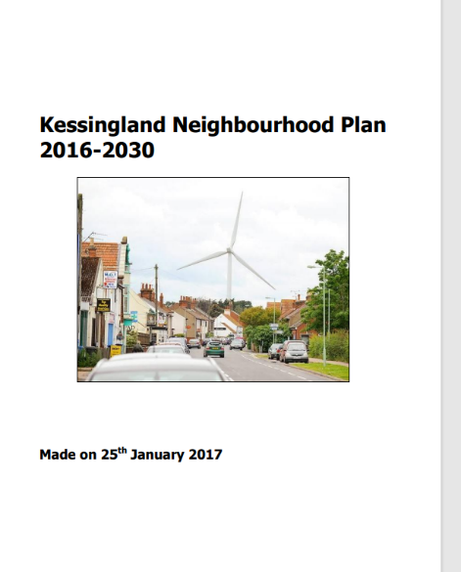
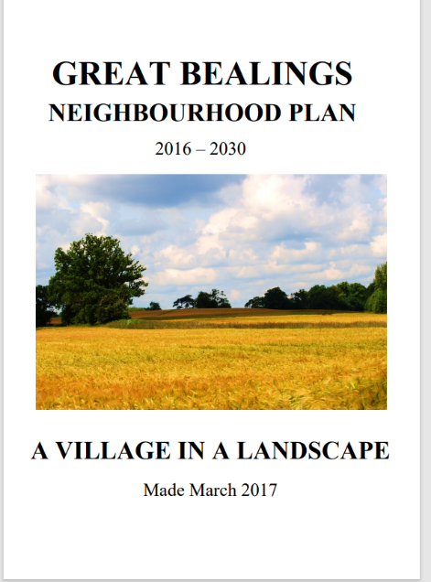
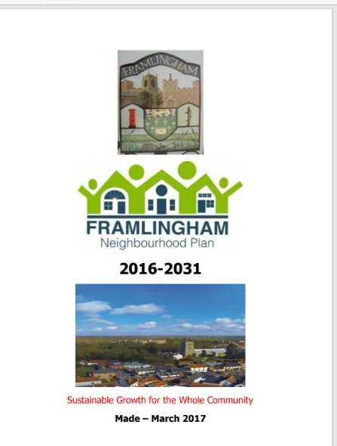
Neighbourhood Plans
Southwold (not made)
Policies restrict new development to assets of community value solely for affordable housing with local connection
Seeking CLH groups to deliver or own new homes to protect from 2nd/holiday market
Kessingland:-
Recognises use of CLT’s as vehicle to
deliver affordable housing
Notes:
The district boasts strong sense of community. These are the NP that are completed. Southwold Neighbourhood Plan, is currently out for consultation and has policies that limit the use of assets of community value for the sole purpose of affordable housing for the Town with restrictive occupancy clauses. They are using Community Land Trust model to protect against the right to Buy and homes being lost to the 2nd or holiday home market. A real problem in Southwold. Kessingland is also using the CLT model to deliver homes for local people. Several more parishes are writing their plans and support will be given to them around community led housing models and policies. If Southwold’s NP is made with the policies remaining, I personally think this could encourage other Parishes to consider these forms of restrictive policies to benefit their community.

Slide 7


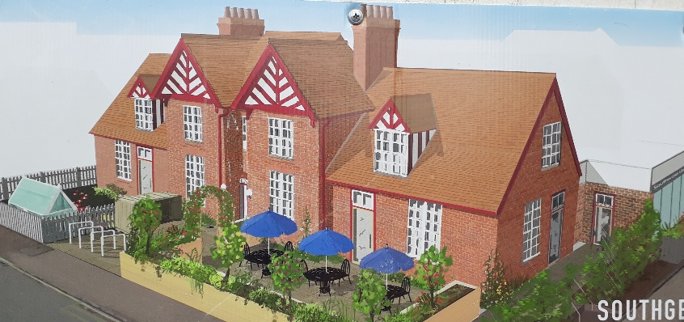
Community Housing Fund (2017)
Suffolk Coastal £1,200,000
Waveney £685,000
Converted 5 open market homes to 4 affordable rent and 1 shared ownership partnership HA
Plus – café & children’s nursery provision – community shares
Experience guided Neighbourhood
Plan policies
Converted 4 open market homes to affordable rent partnership HA
Ambition to deliver future schemes locally
Notes:
I want to tell you about two specific community groups who are delivering affordable housing in their Parishes. Firstly, SouthGen, based in Southwold. They used the governments Community Housing Fund to convert open market homes into affordable homes in partnership with a local housing association. In addition, they raised community shares to deliver a café and childrens nursery. The second group also used the Community housing Fund to convert open market homes to affordable homes in their village. The Peninsula Villages CLT will own the land and lease it to a housing association who will complete the build. This model will protect the homes from the Right to buy and conversely, the 2nd or holiday market.

Slide 8
Aims and objectives of CLH groups
Community Benefit Society (2015)
Empowerment to community
Isolation and education (17 pre school places/library)
Community Shares
Captured community imagination
Community Benefit Society (2018)
Homes protected from Right to Buy
Used CLH Funding set up & equity in land – future schemes
Wide membership
Notes:
These two exciting projects are led by ordinary people who could see a need in their areas. Both are Community Benefit Societies seeking to deliver homes and assets the community need. As part of the SouthGen project, space will be given for a library, whilst the café will provide an informal place for people to meet and access information. The Peninsula Villages Trust have a strategic view to deliver more homes in their area to meet local need. Both groups are democratic, empowering local people and raising skills, whilst reducing isolation and discrimination.

Slide 9
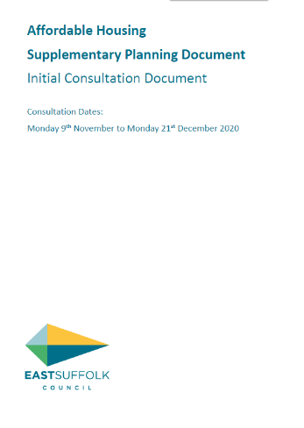
Housing Enabling
Three CLT’s in District, SouthGen (Southwold) & Leiston CLT, Peninsula Villages (Suffolk Coastal)
2 Emerging CLT’s, growing interest.
Started in February 24th 2020
Training for Members & officers CLH and affordable housing April/updated website with case studies
Met with several community groups and PC’s, listening, promoting models.
Providing guidance in Affordable Housing SPD
Developing partnerships and networks
Notes:
Since my arrival at East Suffolk in February, I am pleased to say that progress is on going. I have so far provided training to Members and Officers on CLH models, whilst supporting several groups who are interested in delivering housing or other community assets. Policy work includes supporting Neighbourhood Plan groups and working with planning colleagues on the new Affordable Housing supplementary planning Document. Thank you.

Slide 10
Thank you
Stephanie.Baxter@EastSuffolk.gov.uk
07880 105 421

