Slide 1

Strategy Day Outputs
20th November 2017 - Birmingham
Adopted January 2018 - Manchester

Slide 2
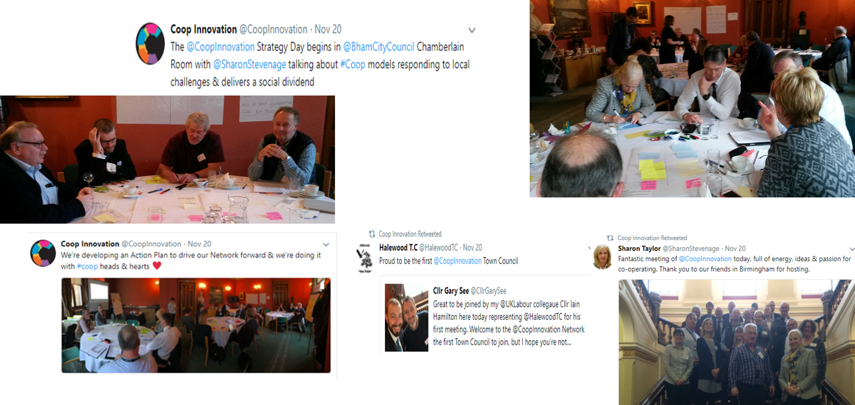
CCIN Strategy Day – 20th November 2017

Slide 3
Attendees
Name | Council/Organisation | Job Title
Cllr Tony Kennedy | Birmingham City Council | Assistant Leader
Fiona Gibson | Cardiff Council | Senior Corporate Policy Officer
Nicola Huckerby | CCIN | CCIN
Shelagh Everett | Co-operatives UK | Facilitiator
Nick Matthews | Co-operatives UK | Chair of CUK
John Montes | Croydon Council | Senior Corporate Strategy Officer
Cllr Iain Hamilton | Halewood Town Council | Councillor
Cllr Peter Curling | Hillingdon (Labour & Coop Group) | Leader, Labour & Co-operative Group
Cllr Gary See | Knowsley Council | Cabinet Member for Resources
Hannah Jameson | Lambeth Council | Head of Policy and Partnerships
Sophie Lloyd | Milton Keynes Council | Policy Project Manager
Phil Hunter | Newcastle City Council | Senior Specialist Policy, Comms & Performance
Beverley Cleary | Newcastle Under Lyme Council | Business Improvement Officer (Performance & Improvement)
Jonathan Downs | Oldham Council | Principal Policy Officer
Ross Jeffrey | Rochdale Metropolitan Borough Council | Policy Advisor- Information, Customers & Communities
Chris Howl | Salford City Council | Policy and Equality Officer
Neville Rowe | Sandwell MetropolitanBorough Council | Housing Strategy & Research Manager
Cllr John Savage | Southampton City Council | Councillor
John Merritt | Southampton City Council | Representative
Cllr Sue Woodward | Staffordshire County Council (Labour & Coop Group) | Leader, Labour & Co-operative Group
Cllr Sharon Taylor, OBE | Stevenage Borough Council | Chair of EOC, Leader of Stevenage Council
Matt Partridge | Stevenage Borough Council | Deputy Chief Executive & Strategic Director
Cllr Simon Speller | Stevenage Borough Council | Portfolio Holder for Neighbourhood & Co-operative Council
Cllr Iain Kay | Sunderland City Council | Council Lead on Cooperatives

Slide 4
Welcome and Introductions
Cllr Sharon Taylor, Chair CCIN
Cllr Tony Kennedy, Assistant Leader, Birmingham City Council
Aims
Understand the CCIN members view of:
  where the network is five years on (2013 – 17)
  how we should shape the strategic direction for the future
  how CCIN members can contribute to the work of the network
Explore and agree how we promote the work of the network, engage other councils and bring our Co-op MPs and Peers on board
Explore how do we engage with the wider Co-op movement
Agree an outline (draft) for an action plan that can shape our work for the year ahead

Slide 5
Outline Agenda for Day
Welcome and introductions Councillor Sharon Taylor, Chair, CCIN Councillor Tony Kennedy, Assistant Leader, Birmingham City Council | 10.30am
Co-operative-Led Housing - John Montes, Croydon | 10.50am
Strategy Session I | 11.10am
Lunch Including an overview of the work by Birmingham City Council on Deliberative Democracy, Cllr Tony Kennedy, Assistant Leader, Birmingham City Council | 12.30pm
Strategy Session II | 1.10pm
Short refreshment / comfort break | 2.20pm
Action planning Session | 2.30pm
Review of day and next steps | 3.05pm
Close | 3.15pm

Slide 6
Expectations for the day (clustered themes)……Outputs
Strategic Direction | Networking and relationships | Gaining Clarity | Other specifics
A framework for future co-operative working. A clear forward plan (for the network). A clear and shared understanding of the way forward for our network. A clear identity (for the network). Share ideas and create a new vision for the network. To identify our priorities as a network. | The opportunity to network with fellow co-operators To explore how we can work together to tackle the collective challenges facing local government That network members feel like they have to belong to CCIN and (understand) how they can help the network grow. As a new member, I want to find out how my (opposition) Group can make a difference Better understanding of how we can improve working together and networking opportunities. | Clarify the Co-op Model the network if seeking to promote To better understand the work of the group and how members can participate in this I’d like to know what is going on and how I can be involved. | To have more clarity on the relationship between councils and co-operative and stakeholder ownership enterprises and commissioning priorities. To re-connect practice to principles … to find / highlight synergy. Understand the potential for co-operative housing. Learn more about the Policy Officer Group

Slide 7

CCIN Strategy Day
Approach: Four high level areas of focus for the day
Where we’ve been
Pre-read
2013 -2017
Where we are as a network
NOW
Action Planning and
Priorities
Where we want to be
2018-20
Where we want to go
2018 +
1
4
2
Operating Environment
3

Slide 8
Where is the CCIN Now ?
How do you feel as members about where the Network is today – its role, focus, activity and impact ?
Step 1: Individually capture 3 or 4 key observations (on small post it’s)
Step2: Discuss / share with your table
Step 3: Cluster and agree three key themes (capture on 3 large post it’s)
Step 4: Report back/Group discussion
Where we’ve been
2013 -2017
Where we are as a network
NOW
1

Slide 9
Where is the CCIN Now ? - Outputs
How do you feel as members about where the Network is today – its role, focus, activity and impact ? (See appendix 1 / slide 26 for individual inputs / post it’s)
Key themes identified by each group. Plenary discussion & clustering.
Where we are as a network
NOW
Profile
(Getting there)
Could be stronger in building more awareness of the co-operative model
Co-op Message out there & established but we need to extend our message to a wider audience& get the co-operative ideology more engrained at ‘Officer’ level in LA’s
Engagement
CCIN acts as a ‘conduit’
Wide range of engagement
Well established network with a group of committed councils who collaborate & work well together
Could strengthen bonds with other networks driving National Policy
Best Practice/Idea Sharing
(strong & getting stronger)
Action Focus (Do more/more focus)
Strong focus on research particularly around service innovation – but can be seen as niche
Focus on translating into action & addressing big strategic issues
Values & Culture
1
Policy Development

Slide 10

Where do we want to be 2018 - 20
Explore the potential strategic direction for CCIN (2018 -20)
2020 – Tweets
Where we want to be
2018-20
Delivering YOUR Vision
Building OUR Community
Supporting OUR Futures
#CoopFuture
Where do members want to take the network (2020)?
For the challenges for now and tomorrow
#CoopsCAN #CoopsDO
2
Nothing #Coops don’t have a solution for
#CoopsCAN # CoopsDO

Slide 11

Where we want to be 2020 – Consolidated Outputs
What will CCIN be best known / recognised for ?
How will CCIN be working as a network ?
Influencing strategic decisions at National level
Promoting alternative visions at the local level - and breaking down barriers to the alternative visions
Finding (developing) & promoting new & innovative solutions to challenges we (communities) face including: housing; inclusive growth; cohesion; care; health & well-being.
Creating better transport, housing, social cares , services
Setting out what we mean by ‘taking back control’ at community level
Action focused / values (delivery, outcomes, positive achievement)
Policy Influence and Thought leadership
Best practice exemplar – first port of call for on-going service delivery models & repository of co-operative good practice
Self reflection / critique
Regional Presences
Making a difference through co-op procurement & commissioning to our local economies
Inspired local government to embrace the co-op agenda (measured by increased in number of co-ops established
Clearer visibility (of CCIN)
Consultancy Network for Co-op Best Practice
Work more closely with key organisation re: strategic matter ie CIH& be ‘the go to’ resource for co-op related advice
Maintain independence (and Integrity)
Expanding the Network audience
Inclusion Process - Inclusivity / Outreach
Supportive, spontaneous, responsive, open & collaborative network (supportive for new comers & learning from each other)
Sharing best practice within the network - & communicating it outside the network
Respected by other networks
Network members will naturally pick up the phone and co-operate across the network
Councils clambering to come into membership because brand (CCIN) recognised as effective
Truly ground-breaking – Innovative
The way some of our members operate will become know as the “Southampton Model” like Emilia Romagna
Not that fussed at being “known” but more so long as we are having the influence
Being understood – clear message
Political “Food Chain” connectivity
Policy Influence and Positive achievement
Within co-op movement recognised as ambassador of co-op values & action
Network Forum
Ensure information flows (both ways – to / from CCIN)
How the Network engages externally
Double membership by 2020
Helping shape work globally(ICA) - as only co-op councils network in world
(could we have) an on-line sharing platform where member councils co-operated
Where and how will CCIN be creating most impact
Other ideas ?

Slide 12
Where we want to be 2020 – Summary
CCIN and co-operative solutions - well understood, visible and clear messaging to promote and develop co-operative approach
Action Orientated – Network members, project and work demonstrates co-operative solutions in action in a wide range of situations
Influence at a national and policy level to promote and support co-operative solutions
Demonstrating how co-operative solutions can provide alternative solutions to public v private models to meet financial / economic and social challenges
Inspiring growth of co-operative solutions and enterprise to meet local needs – growth across a range of sectors
Best practice exemplar – provides a range of information, resources and opportunities to collaborate between members (growth through learning sharing)
Active in a working with others and respected as a network and Councils for what we do and innovative solutions
Expanding influence and wider audience(s) – extend reach of opportunities for co-operative solutions to strengthen local areas / communities
Growing membership of council’s (double size) - network’s ‘brand’ recognised as effective

Slide 13
Operating Environment 2018-2020
Coop ways
of working
& approaches: opportunities & solutions
Context in which Co-op Councils are operating: challenges & issues
Operating
Environment
Step 1: Small group discussion – reflect on operating environment (add other significant points if required)
Step 2: Identity your top 3 -5 areas that you feel there could be a strong co-operative opportunity. Capture on cards (one per card)
Step 3: Plenary group capture and cluster
3

Slide 14
Operating Environment 2018-2020 - Outputs
Strong co-operative opportunities identified. Plenary discussion outcomes.
(Co-op/CCIN) Knowledge & Skills
Identify & Map true expertise in CCIN
Knowledge share / easy to identify those with skills / expertise
Build Capacity (Officers / Cllr’s)
Growing the local economy
Co-ops creating jobs & skills
Procurement – leverage local spend
Taking advantage of alternative funding (crowd-funding) – create investment as well as community buy in
(Tackling)
Food Poverty
Foodbanks – suits co-op working, makes real difference – also very visible
Community gardens, cafés, allotments
Food Co-ops Distribution Fruit & Veg + Education around Food
Social Care
Co-op models for:
Care Workers
Cared for (& families) Specialist Support
Home Care Co-ops – to stabilise workforce & provide opps for care workers
Commissioning models & approach
Co-op approach to Co-op for older people, linked to local community
Housing
Tenant & resident engagement
Community Led Housing / tenant led social housing
National focus on housing give opportunity for Housing Co-ops
Links to tackling homelessness
Funding
Local govt & public sector
Participatory Budgeting
Co-op ways of working (Local VCS) developing community led solutions eg local budgeting
Libraries
Prevent closures by Co-op models (& reputational damage) & maintain presence across LA
Tackling inequality
Financial Poverty / Health – local education
Prevention Models
Engagement/early interventions / adult & children's services
Public Realm
Co-op approach to making public realm safe, pleasant & healthy for everyone

Slide 15
Co-op Councils Operating Environment
(examples shared on day)
Local Government, and other public sector, funding cuts
Housing Crisis
Crisis in Adult Social Care and looming in Children’s Services
Impact of welfare reforms (including UC roll out)
Increasing demand on council services
Services being closed/reduced
Rise in the use of foodbanks / impact of fuel poverty
Impact on health and wellbeing - particularly mental health
Focus on higher needs cases prevents an early help approach (children’s and adults services)
The impact on the local VCS (incl. current commissioning models)
Failure of the Big Society in areas of greatest need
Recruitment and retention of staff in the public sector

Slide 16
Extending our Influence and Impact
Cooperative Movement
Key Groups Influencers
Members
CCIN and
Cooperative Solutions
Where we want to be
2018-20
2

Slide 17
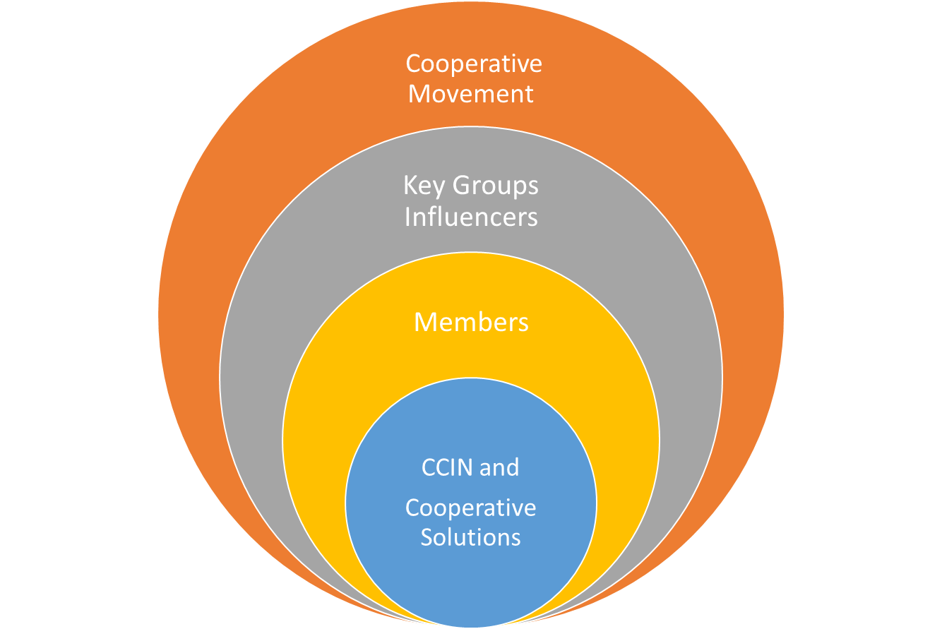
Extending our Influence and Impact
Mini
World Café exercise
World Café style session based on four areas to increase influence and impact
How can members contribute to the work of the network and our impact
How can we promote the work of the network
Who are the key groups we need to influence and how do we best do this?
How do we engage with the wider co-operative movement

Slide 18
Who are the key groups we need to influence and how do we best do this? Outputs
Why (areas to influence) | Who / Key Stakeholders | What / How
Expanding and strengthening the network Promoting Co-op ideas and values | All political parties Jeremy Corbyn (Labour Party) Claire McCarthy (Co-op Party) Ed Mayo (Co-ops UK) Ariel Guarco (ICA) Metro Mayor: Sadiq Khan, Andy Burnham, Steve Rotherham Residents and Community Leaders Members and Officers | Exhibitions Conferences Showcasing policy work Commercialisation agenda – income opportunities
Understanding of co-op principles and ways of working beyond those that are traditionally engaged | Officers / members beyond those attending CCIN sessions 38 Co-op MP’s, Co-op Peers, Co-op Councillors PM and cabinet | Using Co-operatives Fortnight and International Co-ops Day to promote and share what we do (CCIN) Combination approach: Direct targeting and social media opportunities
Areas where there is not a public or private solutions | Local Champion Our respective “CVSE” sectors Civil Service Policy eg Cabinet Office or particular areas where reviews taking place (housing) | Community commissioning at a very local level
Neighbourhood work (or estates) | Local Co-op Teams (Co-op Group?) Community Reps Ward Members Officers /FLS | Public Realm “small” works X Locality Budgets

Slide 19
How can members contribute to the work of the network and our impact ? Outputs
Drivers – to contributing to CCIN | What – ways to contribute | How
Shaping National Policy (Manifesto development – change of council control) | More visible (CCIN) – eg Statements, meeting Ministers etc | Lead on key themes
Local Economy benefits of co-op model Successful small examples of co-ops (care, housing etc) | Best Practice for Local Economic Development – and other areas | Share learning
Positive PR opportunities | Tell us (CCIN) what you are doing – case studies | Workshops Conferencing Networking Champions
Membership engagement and growth |  | Promote the Network Shared platform for people who have questions to get answers from champions / experts

Slide 20
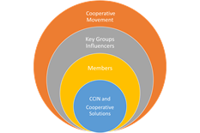
How can we promote the work of the network ? Outputs
(Any) Key Themes | What | How | Who
Health Social Care Housing Employment | Best Practice and Research | Showcasing Away Days Conferences Normalise the ‘Co-operative’ way of thinking (getting the co-operative solution across in plain English) | Engaging Metro Mayors and other key regional influencers
Participatory budgeting | Start with Co-op Cllr’s engage and enthuse then get them to spread the message across groups and Council Leaders Lawfully audacious action! (Note: what can legally be declared)
Manifesto – do we need one? | Key process and policy drivers | Need Action Plan that members feel able & confident to lead on specific areas Pledge(s) Engage other networks Lobbying | Engagement with Government (of whatever colour) X-Ref other plan for: MP’s; Lords: Media

Slide 21
How do we engage with the wider co-operative movement ? Outputs
Key Areas / Themes | Who / Where in movement | What / How
Lobbying Partnership Building | MP’s / Lords EU “Think Tank” Partners | Health Care / Social Care / Housing / Employment Direct lobbying (lobby days) Lobbying by media Social media Lobbying by correspondence
Demographic / generational “black hole” in co-op membership (Understanding?) Partnership Building | Hospitals / NHS / CCG’s etc Police / Fire etc Social Landlords Other Councils Other networks / communities etc | Strands of Co-op Investment Direct interaction Policy Exchange Representative bodies – working groups Conferences Case studies
Find out how it works (Understanding the wider movement ) | Invite ourselves (attend) to wider Co-op events
Communications Plan (CCIN) |  | Develop a clear and succinct story which attracts interest Local Government Press / Media Talk more about the local ‘dividend’ from Co-ops

Slide 22
Emerging Themes to input to 2018+ Action Planning (1)
Plenary discussions, along with the outputs, highlighted a number of themes and specific priority areas for consideration as part of the planning process for 2018.
Action Planning and
Priorities
Theme / Focus area | Potential Action / Follow up
CCIN Focus / Impact Five years on significant research completed by CCIN – time is right for shift to more ‘Action’ orientation | Current challenging climate gives CCIN an opportunity - ‘time’ is now for co-operative solutions Identify opportunities to prioritise work in 2018 to focus on : Impact (Action) through (Innovative) Co-operative solutions - and reduce level of academic research in CCIN portfolio of work Review how to communicate with CCIN members both the opportunity and shift in focus from 2018
Voice /Clarity of message Co-op model can be complex to understand – and awareness is patchy, or misunderstood. | Identified as a key barrier to getting message over and openness to Co-op solutions is the mixed understanding of the model. Agree CCIN needs an simple, clear set of messages to explain ‘ what co-op solutions are; what they look like in public services and what are the benefits’ (elevator pitches) Messaging to built into Comms Plan and used as a CCIN level but also available to members to use in their LA’s / Council’s. The confusion about co-ops also eats time and resource to try and explain and can lose opportunities through lack of understanding.
Vision and Strategy | Aspiration to develop 2020 Vision and linked high level simple strategy to act as a guide to the work of CCIN and support adding value to members and attracting and retaining members
4

Slide 23
Emerging Themes to input to 2018+ Action Planning (2)
Continued …..
Theme / Focus area | Potential Action / Follow up
Resources – optimising value / use CCIN has generated a wide range of case studies, resources and know how. Opportunities to identify how to better communicate the overall message (Sun of part) and connect more members with resources / fellow members | Improvements to website a positive start. Now communications ‘in-house’ opportunity to review how to get best value out of resources, b created by CCIN members or projects. Potential at two levels: Building the wider CCIN narrative at a macro level Identifying a simple solution to make it easier for members and other to find or be aware of the depth of work / resources available Identify is a simple solution can be found for post questions or connect members more easily around themes
Influence and Impact | Review model and ideas and build into 2018 Communications Plan approach and priority people or organisations to seek to influence. Identity ‘optimum’ opportunities to be able to access / influence key people / org’s mindful of limited resources Consider prioritising key themes to use as anchors to simplify messaging
Wider Movement | Timely to revisit with Ed Mayo progress and direction of the CCIN and test back against the early questions posed to the Network by Co-operatives UK Opportunity to use the recent National Co-operative Development Strategy 2030 (NCDS) key themes to support future work and CCIN contribution to wider sector through its co-operative action.
Action Planning and
Priorities
4

Slide 24
Emerging Themes to input to 2018+ Action Planning (3)
Continued ….
Theme / Focus area | Potential Action / Follow up
Macro / Micro level impact Opportunity to build on positive work at member level and draw out synergy across work / theme -Bottom up (from members ) top down / across (from CCIN) | Opportunity to reflect in balance of messaging between what members are doing (bottom up) and what the CCIN may wish to comment on at a more holistic or macro level Opportunity to look to agree a high level framework on shared areas and views when CCIN can start to develop more network wide messaging or communications to help promote the co-op opportunity and story or positioning Potential to consider developing a shared narrative (manifesto) to create common set of messaging, policy influencing and lobbying prioritises (using member action and solutions to demonstrate evidence of co-op solutions in action
Action Planning and
Priorities
4

Slide 25
Review of Day and Next Steps
Outputs from workshop to be captured and provided to CCIN
Outcomes / summary to be shared with attendees for feedback
Use strategy day discussion and outputs to inform Executive Oversight Committee review of key themes and ideas to shape 2018 (potentially 2020) Action Plan
Use ideas generated and outputs to inform the Communications Plan for 2018
Elevator ‘pitch’ to be developed for CCIN
Review holding further strategy day in 2018 with potentially a wider audience

Slide 26
Where is the CCIN Now ? – Outputs APPENDIX 1
How do you feel as members about where the Network is today – its role, focus, activity and impact ? Individual Post It’s / inputs used to generate key themes (see slide 9) – rough cut / cluster to simplify presentation raw content.
Improving profile for network but needs more work Strong sense of identity (ie that there can be co-op solutions to many challenges facing local areas Profile has been raised in recent months but still not clear whether the ‘so what’ element & pitch is clear enough to attract more members Co-op message is out there – need to greater uptake particularly at officer level Becoming more influential Awareness raising of the networks journey and work still to do Is our voice heard ? | Growing & evolving core cluster of active members Network needs to champion, highlight & celebrate work of all its members not just limited to 2 or 3 Some very enthusiastic members, who need to enthuse their colleagues. How? Growing number of interested but non committed “observing/sympathetic” members The network works well together Membership organisation v network? Now established with a core group of very committed councils Expanding membership Growing in size/significance/members | Need to expand understanding & passion for co-op councils beyond usual suspects among both members & officers CCIN & co-op solutions currently seen as “niche” Lack of culture of pursuing co-op solutions The innovation is in the co-op model! How to start embedding co-operation & CCIN values in LA’s so it doesn’t just sit with individuals Co-operative working = antidote to fragmentation & alienation in communities - how to develop / share principles | Continue to move away from academic approach to action focussed approach Need for great action focus Very active discussions – doesn’t always translate into action? “Concrete Cases” x “Learn by DOING” ACTION (greater than) > “policy” Lots of good knowledge but needs translating into Action Growing slowly – lots of conversations – need help in clinching deal Research Driven Case studies demonstrate how much co-operative working is on going in member LA’s – is there much being done to work together to share lessons learnt ?
Clarity re: where CCIN fits in line with the various components of co-op movement NOT about turning Councils into Coops Councils in difference places | What’s the best way to get member questions out to the Network? Who are the ‘co-op’ leads for each member A really strong membership base, but difficult to keep everyone engaged | Need to consider how we ca get consistency of policy support as time goes on and chair’s change National policy shaping? Not sure? Is this important? Put co-operative policies into action | Engaging with communities to build local strategies Historical top down economic development focused on inward investment rather than endogenous !
CCIN – the best it has ever been re: profile/focus/ action activity/lobbying /campaigning / resources Strong best practice ideas/sharing Good information available | Relationships with other networks? Drive from Councils - Drive from Comms Engaging with new organisations – NALC / T & P Sectors | Challenges of political / financial environment gives new opportunities for new ways of thinking / delivering | Developing new frameworks Developing policies and approaches Sustainability through political change Policy labs seen as a strength & opportunity pipeline

