Slide 1
CCIN Annual Conference
Creating a co-operative commonwealth
4 October 2018
Simon Parkinson, Chief Executive and Principal,
The Co-operative College

Slide 2
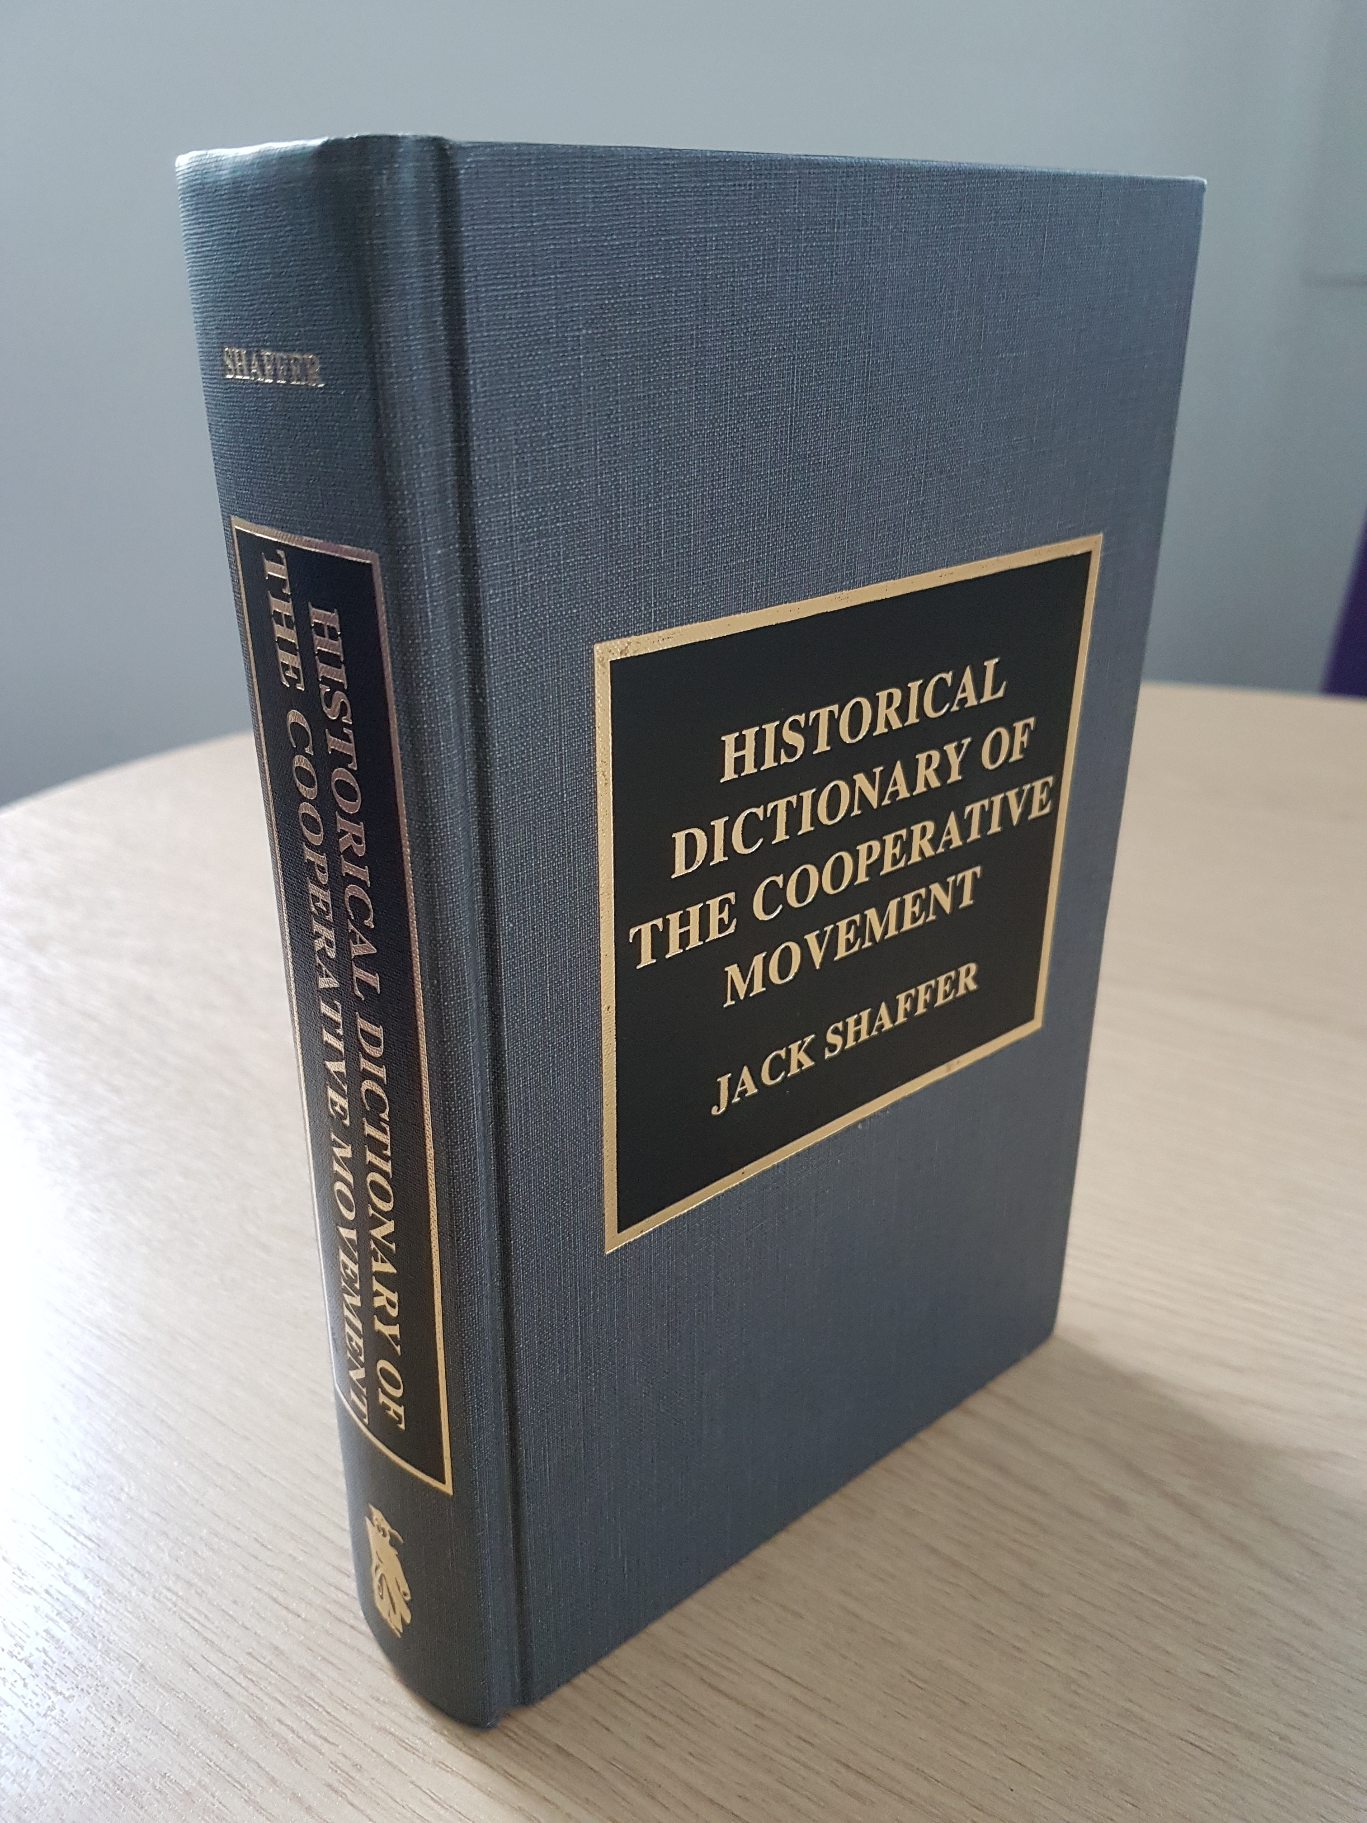
The Co-operative Commonwealth –
A definition?
The proposal by some co-operative theorists that society be organised according to a co-operative political system managed by a co-operative congress, paralleling an economy that would be almost entirely structured along co-operative lines. The plan is regarded as visionary by most co-operators, but many writers on co-operation favor change in the direction of a co-operatively motivated public opinion, informed by the teaching of co-operation in schools and an increasing emphasis on the achievement of co-operation through legislation.

Slide 3
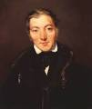
The Co-operative Commonwealth –
A long and contested idea (ideal)!
Can probably be traced back to Robert Owen (1771-1858)
The ideas around utopian socialism and intentional communities in both the UK and US (New Lanark / New Harmony)
Maybe ahead of their time or unsustainable social experiments?
1844 Rochdale Pioneers: Law First – to arrange the powers of production, distribution, education and government.
Sounds like the Co-operative Commonwealth!

Slide 4
Seminal early text on the Co-operative Commonwealth
Laurence Gronlund: The Co-operative Commonwealth in its Outlines. An exposition of collectivism.
Published 1890 and in many later editions.
Available as a full download
Led to Ben Jones in his 1894 survey "Co-operative Production" quoted J. C. Gray

Slide 5
A Co-operative Commonwealth in Bolton
“The last society I have to notice brings one back to the old Owenite days…Last evening I visited a novelty – a communistic society actually existing in a busy town like Bolton. The men are all socialists, followers of Gronlund and Bellamy. They have for two or three years worked in the evenings, without any pay for the common good of the society…..They never think of the work as drudgery. I never saw working men with such confidence in each other…. At present all the work and all the profits go to build up a fund to build up a “Commonwealth” on a large scale.”

Slide 6
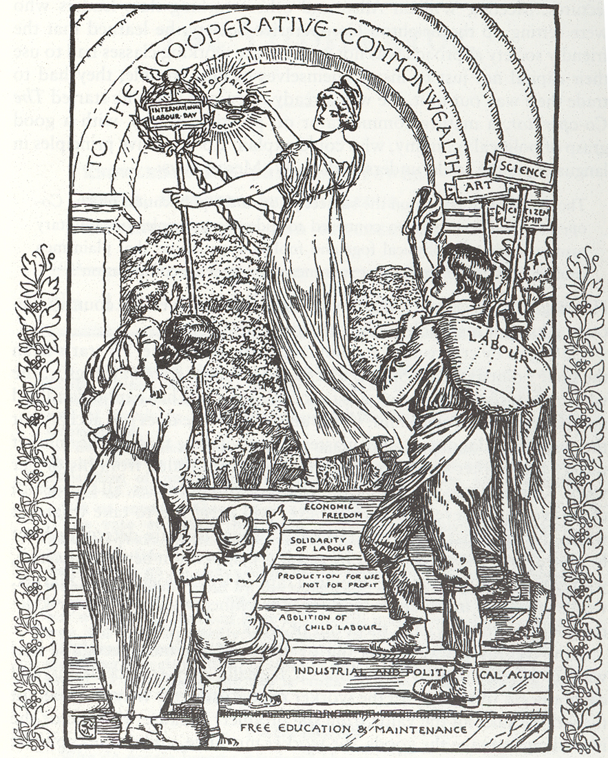
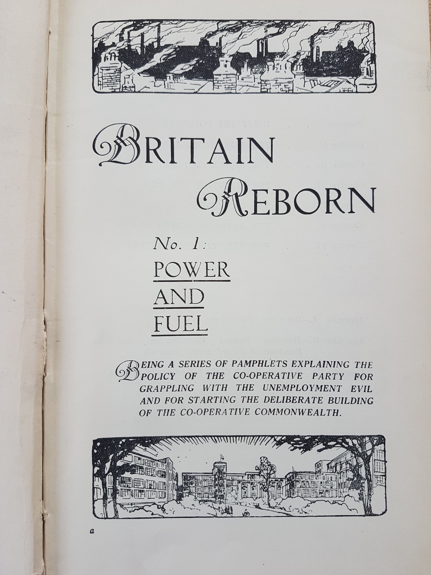
A constant anchor point through the late 19th early 20th Century
No 2 – Transport
No 3 – Countryside
No 4 – Buy British
No 5 – Men & Money

Slide 7
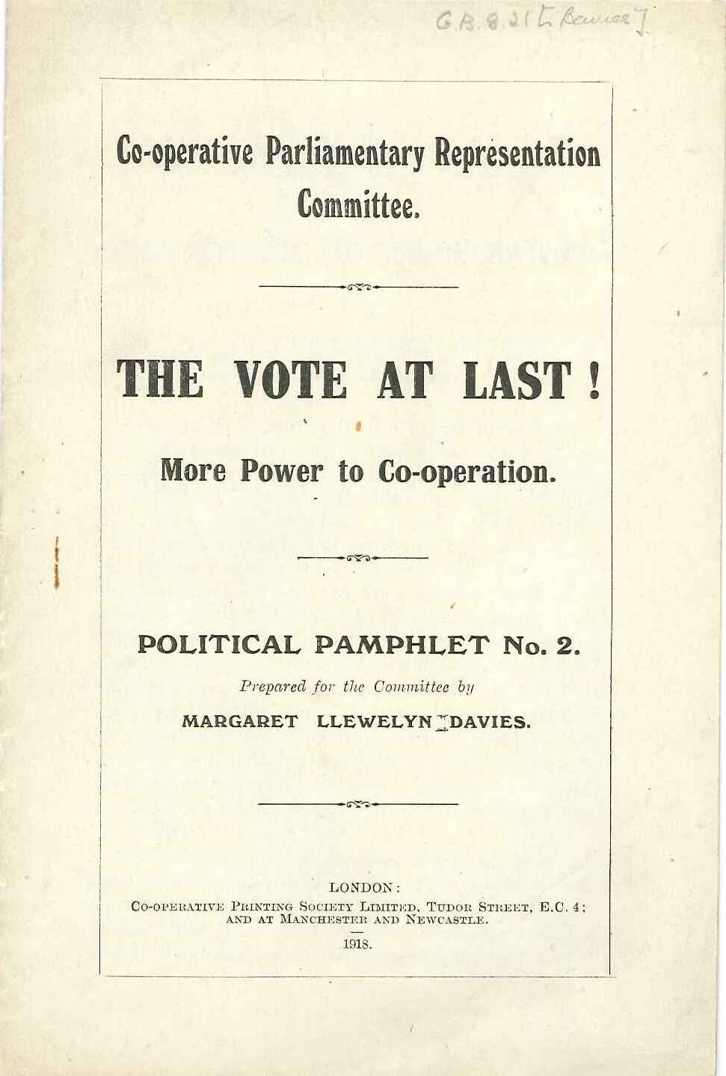
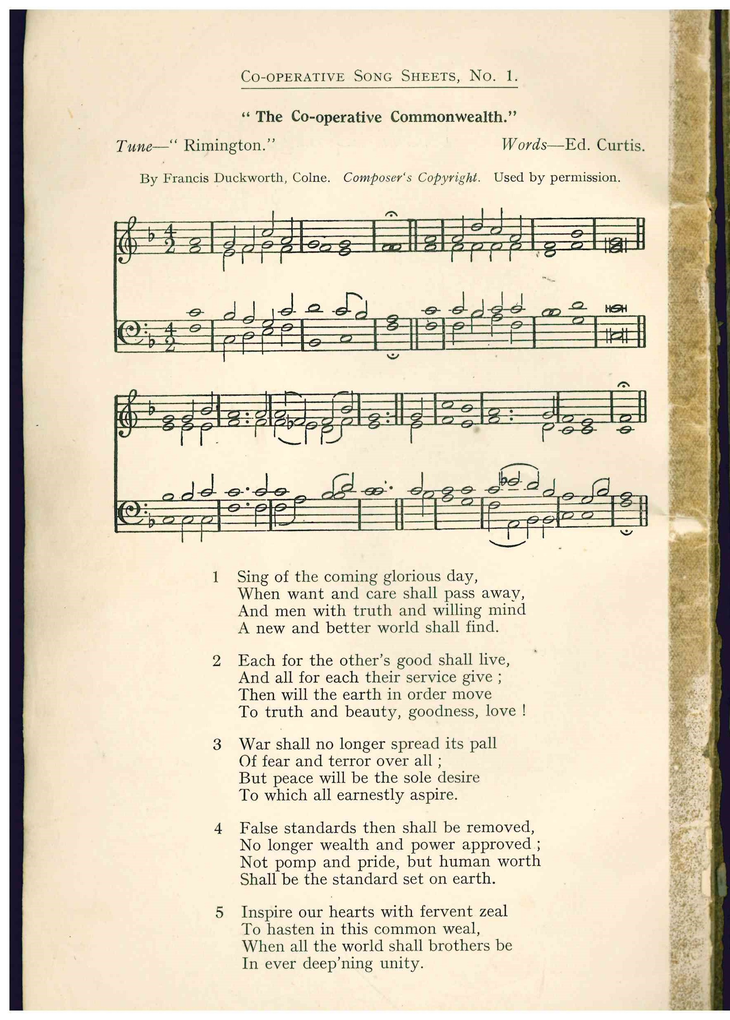
Not just men and worthy of an anthem

Slide 8
Further info
Simon Parkinson
Chief Executive & Principal
The Co-operative College
www.co-op.ac.uk
simon@co-op.ac.uk
Twitter: @simonparkinson6
National Co-operative Archive
www.archive.coop
archive@co-op.ac.uk

