Slide 1
What does a sustainable society look like?
Unmet
needs
Outside of our ecological footprint
Notes:
It looks like a donut…. anyone who has read Kate Raworth’s fantastic economics book, knows where I’m going with this.
However you measure society and in particular economic growth, the goal is to meet our human needs.
There is a sweet spot between, doing too little to meet our needs, and doing too much that can’t be sustained, whether as an individual building up debt or a society living beyond its ecological footprint.
For me, a sustainable society, has to also be a just society, where everyone's at least basic needs are met.
What has this got to do with Co-ops?
For a lot of businesses, their primary goal is to maximise shareholder financial return, they are not doing their job properly if they don’t, and when pushed to the extreme this comes at the cost of everything else.
Like workers conditions, the climate, held in check mostly by the law, brand reputation considerations?
Co-ops have as their primary purpose, to maximise member benefit. This more nuanced purpose provides space for members to look at their wider social, environmental and economic needs and values like equality.
So more sustainable, more just society needs more organisations like co-operatives.

Slide 2
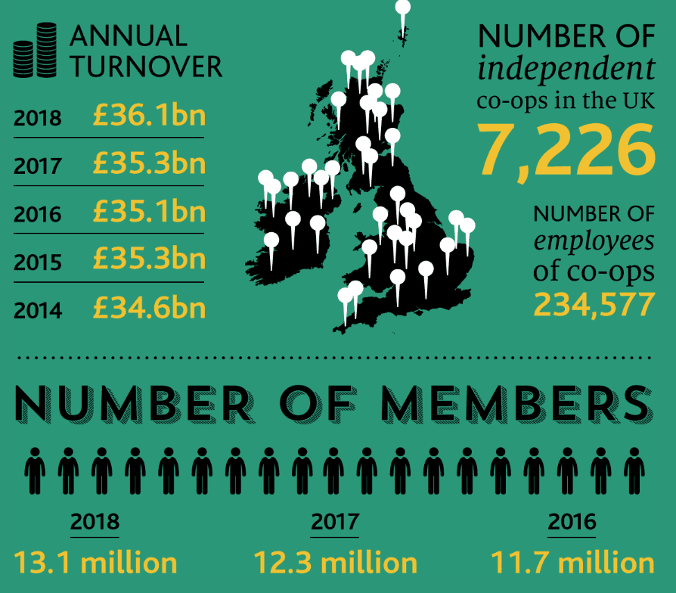
Notes:
Although we are rightly proud as the birthplace of the co-operative movement, now made up of more than 3 million co-ops and impacting 1.2 billion people who either support their livelihoods or use the services of co-ops around the world. Yes, I did say 1.2bn. Its fair to say we are now lagging behind in the co-operative stakes.
7,000 co-ops and 36bn are good numbers, but this is what 1% of GDP? – To make a real step change in the creation and growth of co-ops, will mean overcoming barriers.
One of the big barriers and highlighting more recently from our conversations with Mathew in Preston, and this is no different from other areas. Is how we bridge the gap between people willing to commission and purchase the services of co-operatives and the ability of their local communities to create co-ops that are capable of tendering and delivering that work.
This is partly an awareness issues, people just don’t know its an option, but beyond that is about building confidence and providing the capacity building so local people are in a position to help themselves.

Slide 3
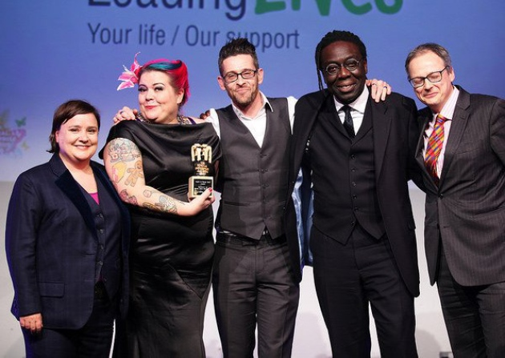
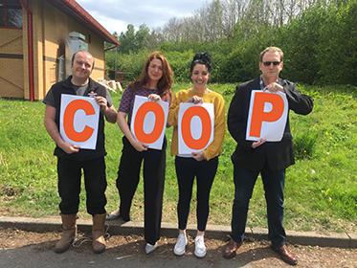
Co-op success stories
Cartrefi Cymru, Wales Multi-stakeholder co-op
Leading Lives, Suffolk
Employee co-op
Notes:
There are examples of success, like Leading Lives, an employee owned co-op spun out from Suffolk Council 8 years ago. More than 400 worker members delivering social care services in Suffolk.
And Cartefi Cymru who converted to our multi-stakeholder co-op last year, with more than 1200 employee supporting people with learning disabilities throughout Wales

Slide 4
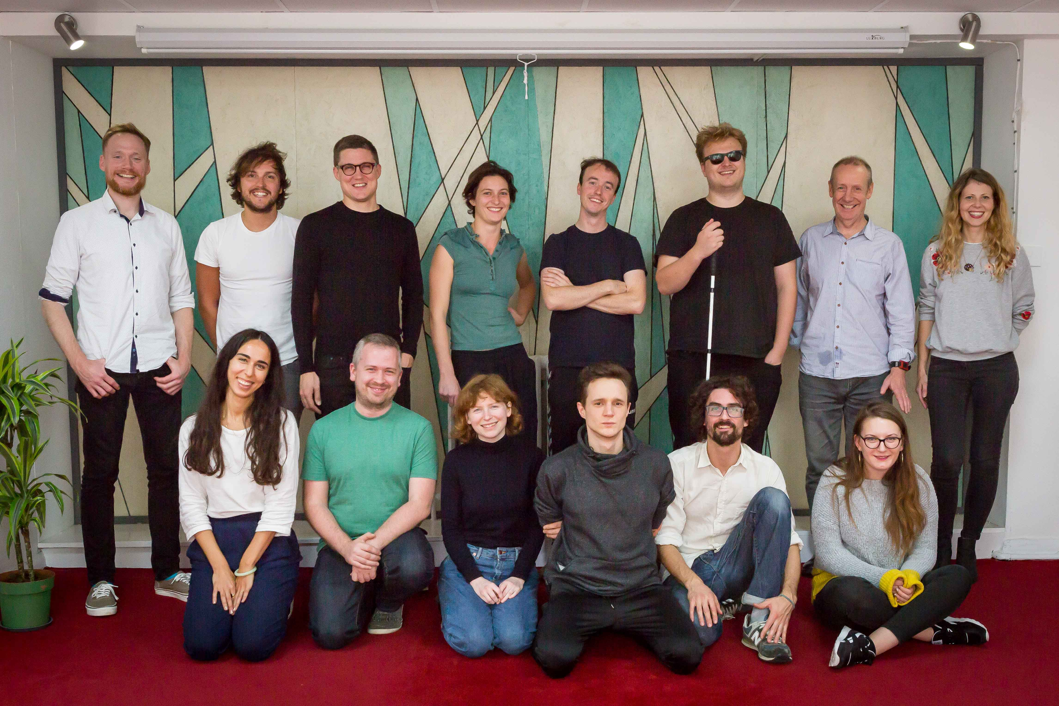
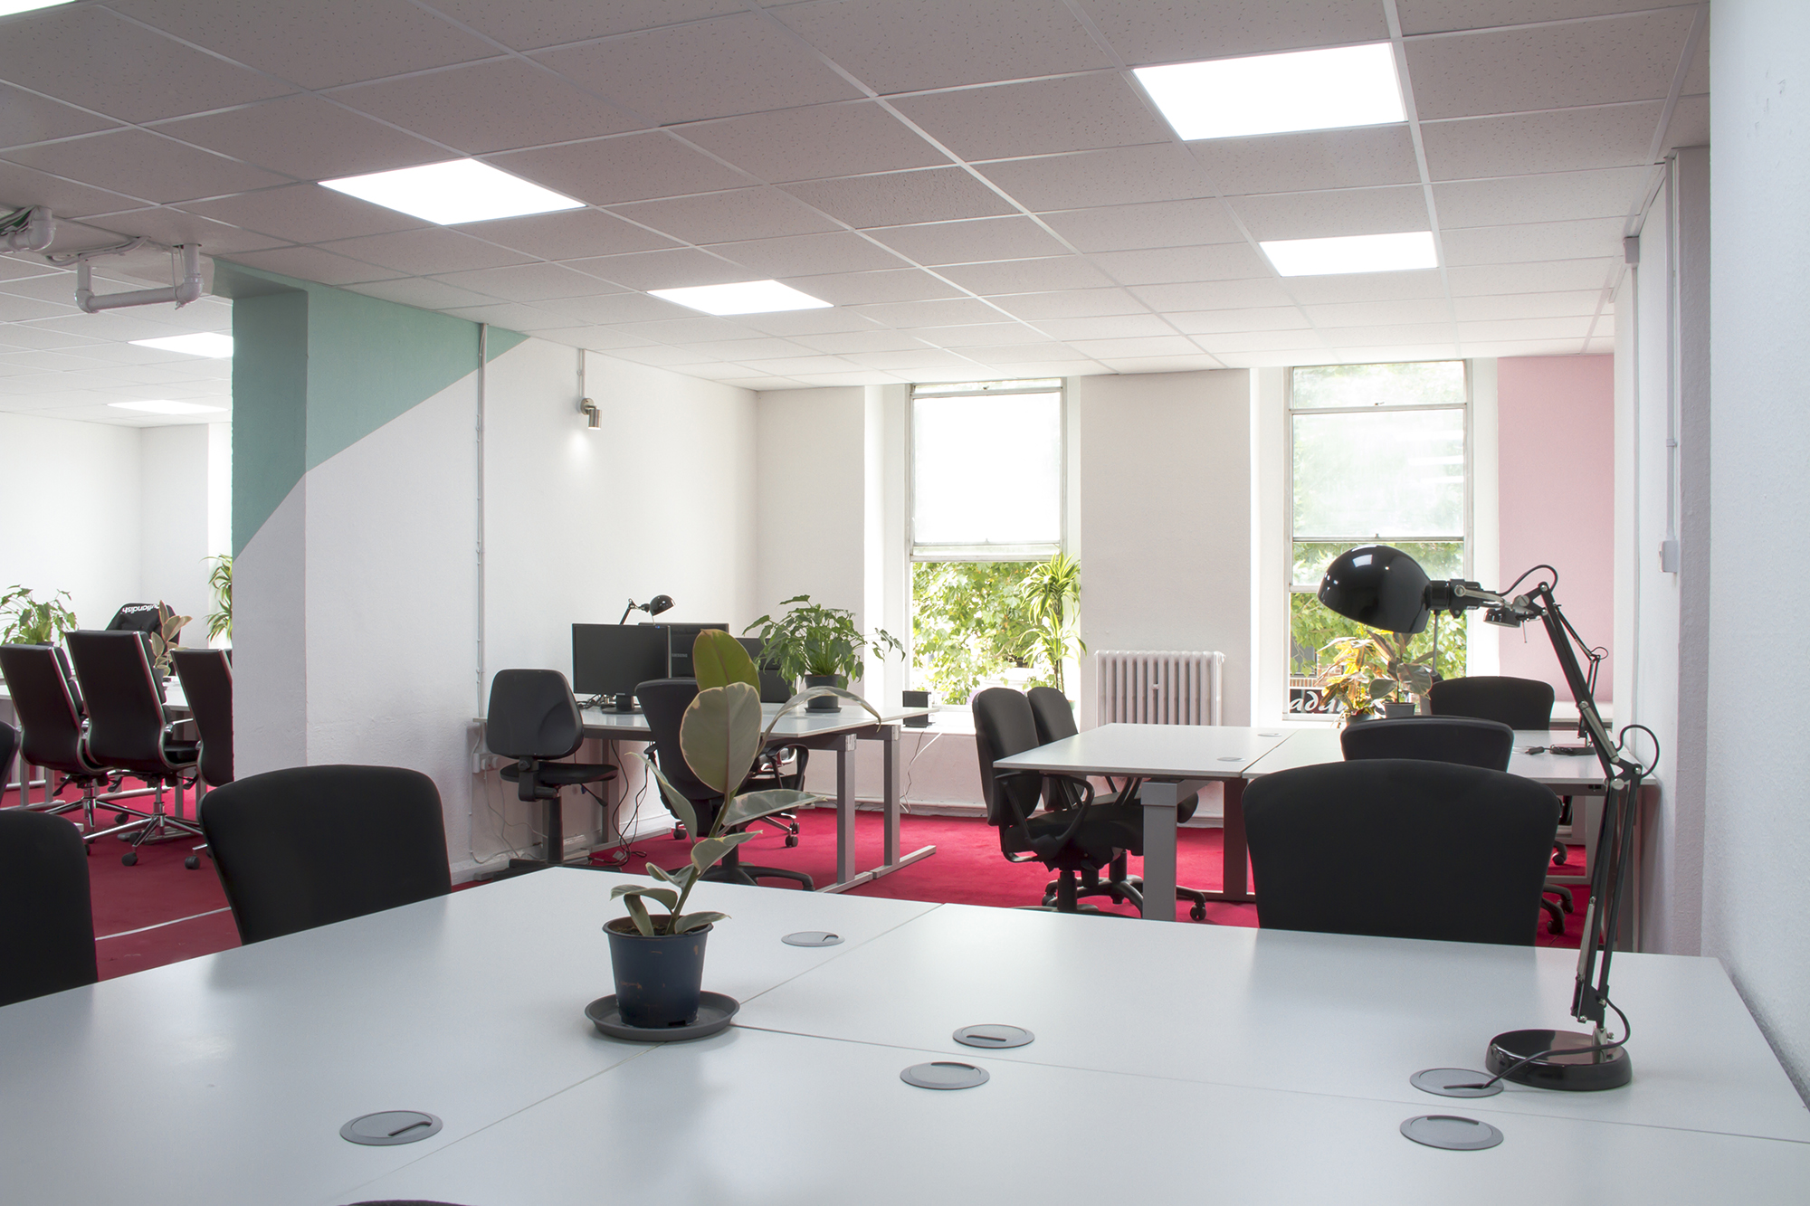
Space 4 / Co-tech
Co-working and tech network
Outlandish, Finsbury Park
Worker / Freelancer co-op
Notes:
And from a different angle of providing a service to the community is Outlandish in Finsbury Park. I’ve chosen this as in some ways they are no different than other profitable and successful tech start-ups in London, but it’s the projects they support and what they do with their profits that’s different. Their pay is much flatter and ownership is spread between employees and committed freelancers they balance working with bigger businesses and supporting tech based campaigns like the Schools Cuts website that ran during the last General Election. And they invest in a co-working space to support future tech co-op businesses locally and wider network, now made up of over 30 tech co-ops.

Slide 5
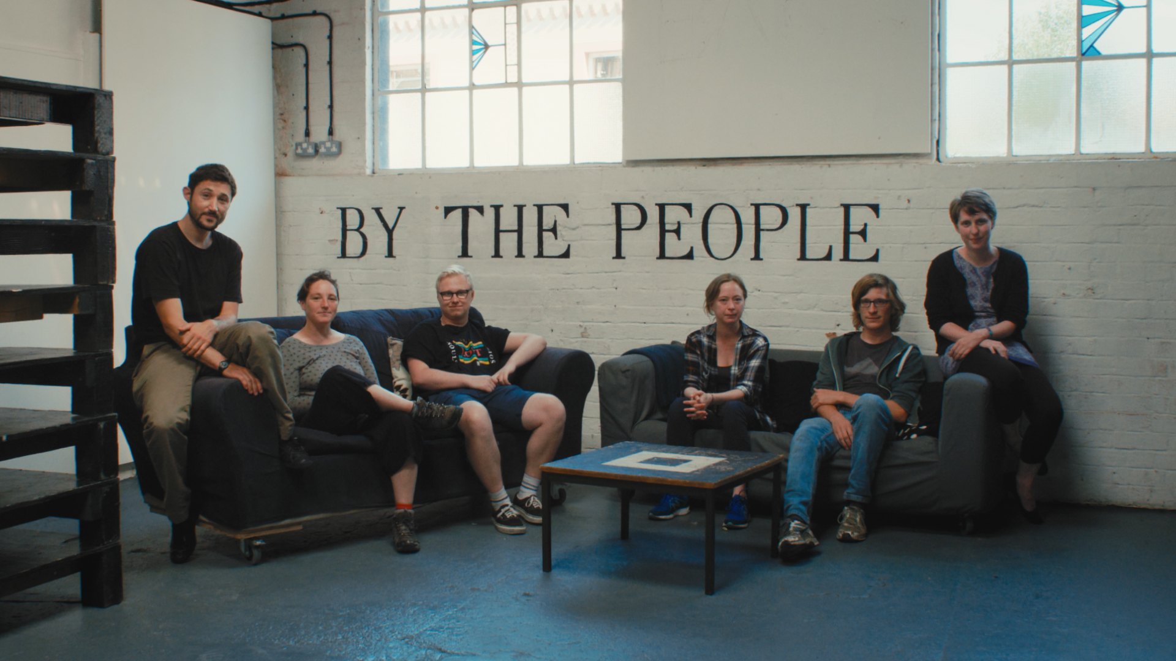
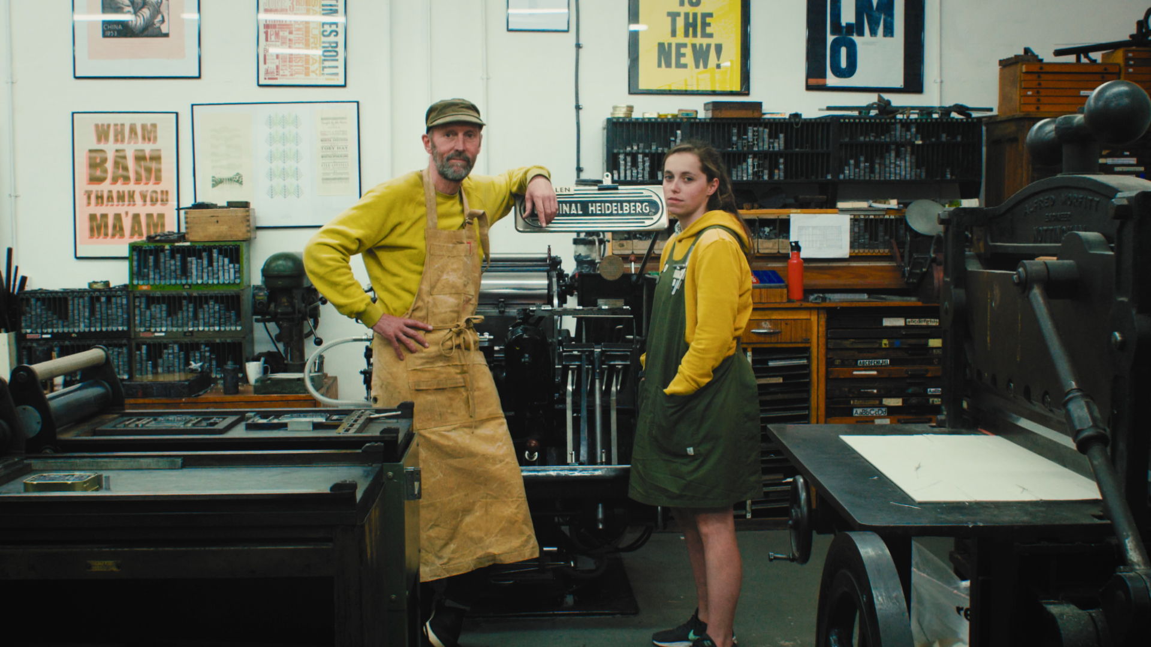
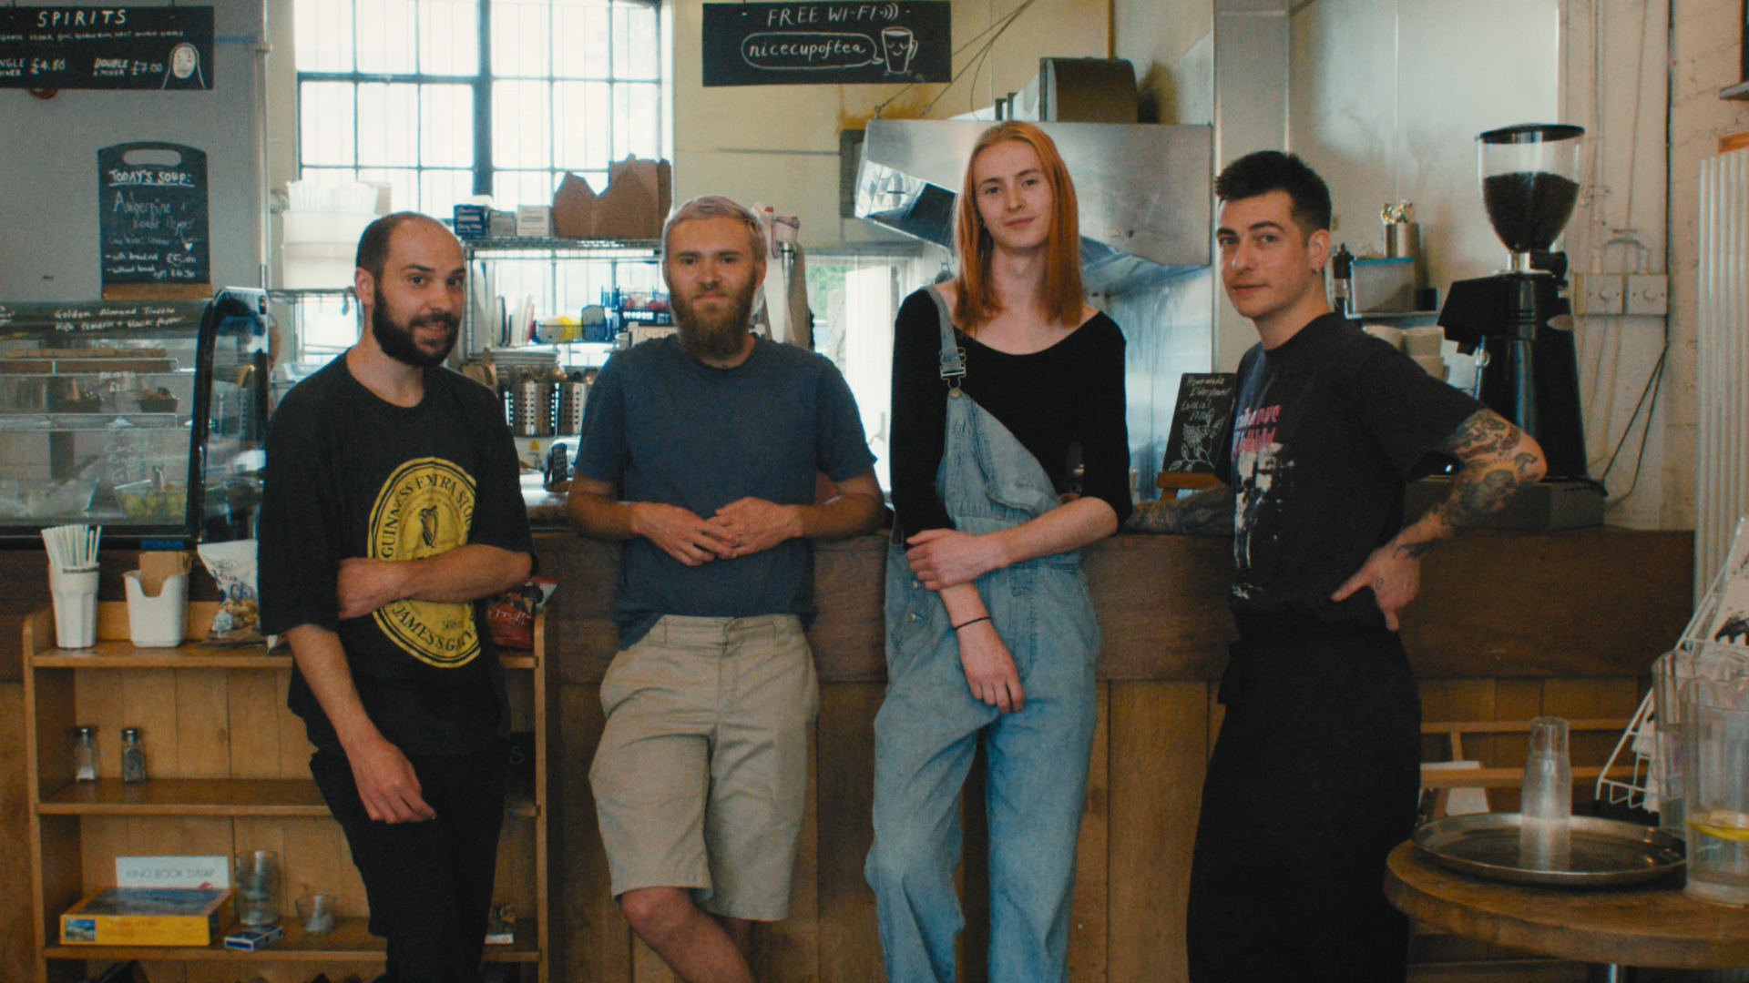
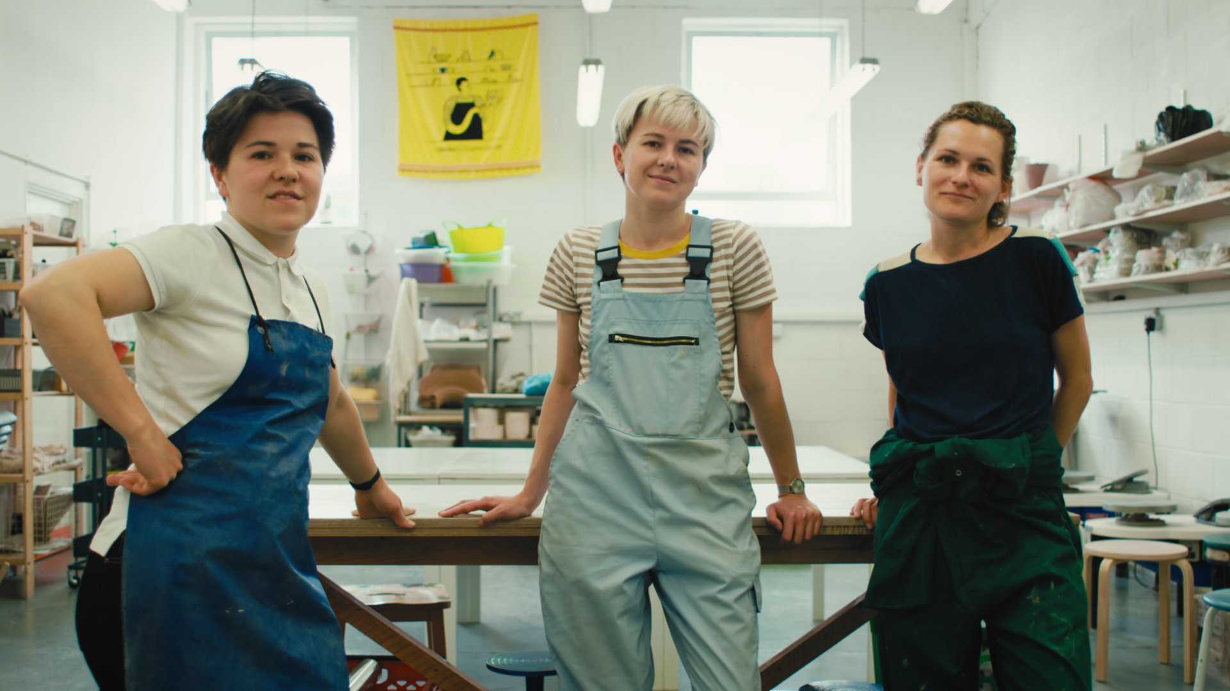
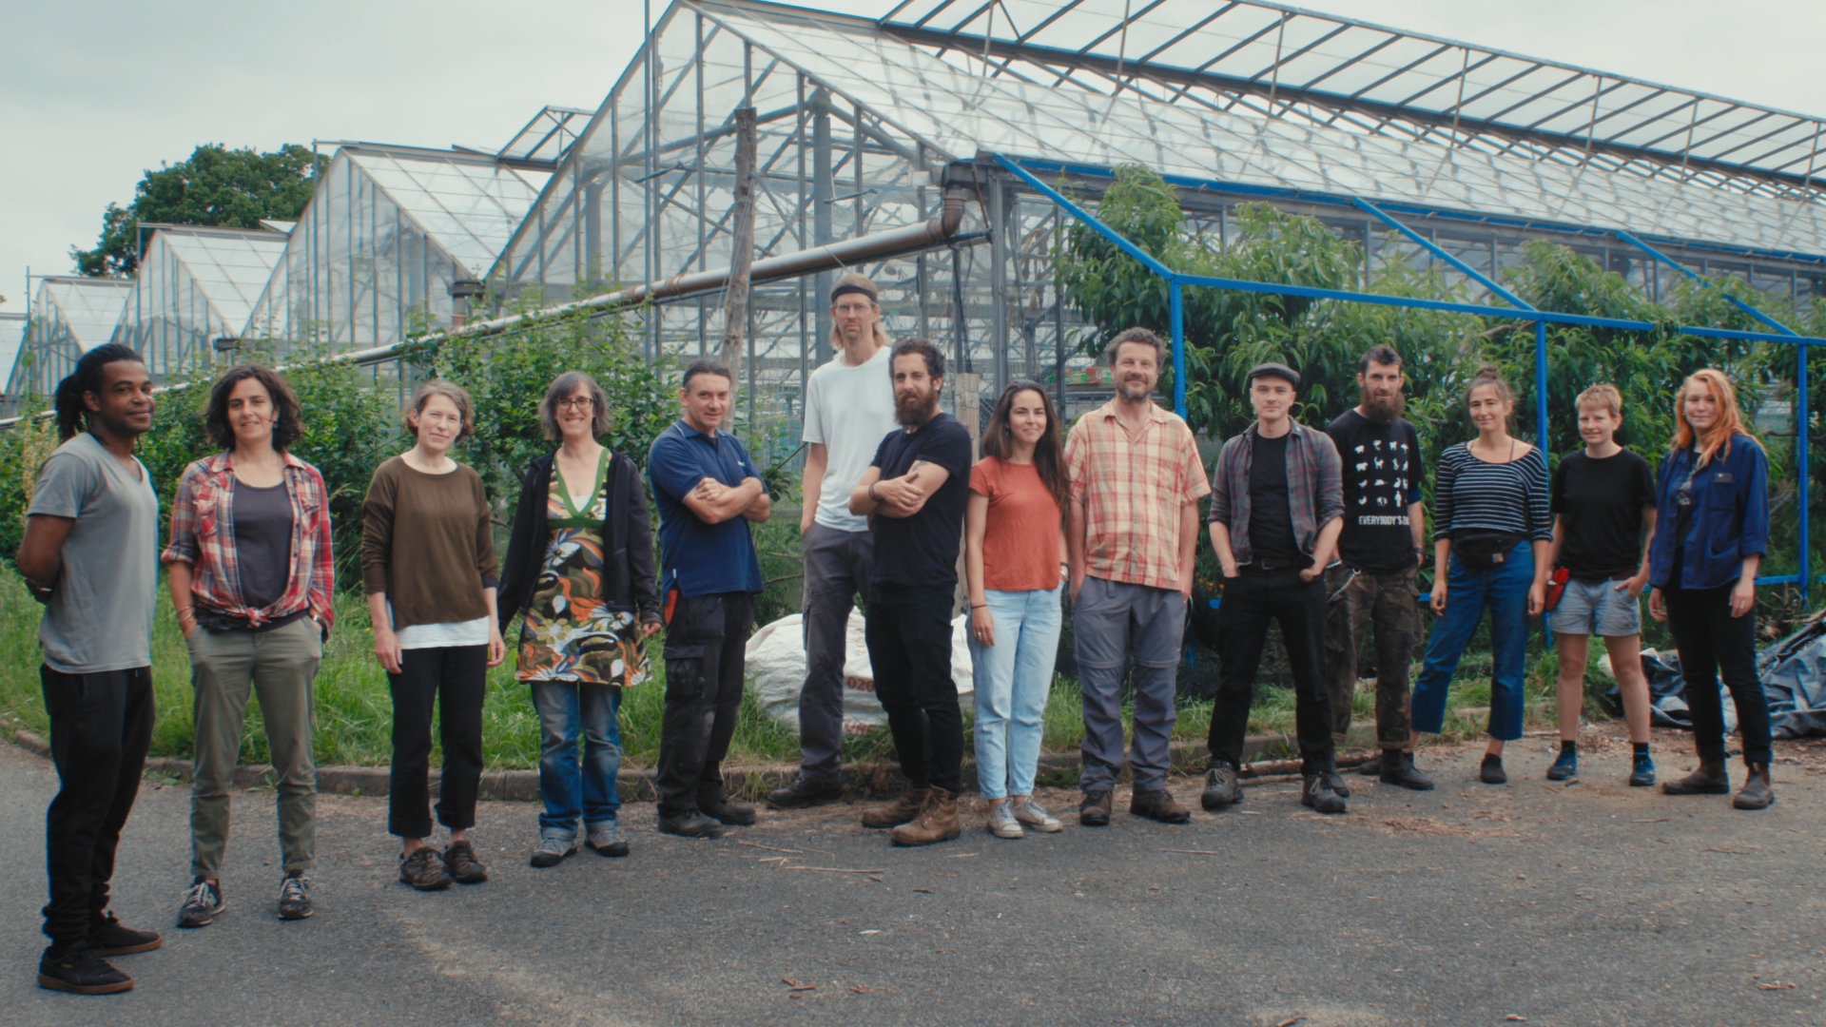
Notes:
Co-operatives by their nature are people focused not profit focused businesses, but by their nature they also rely on people coming together. This is hard not least because public awareness is really low.
If we want to develop sustainable local economies then we need our political leaders and local authorities to help raise awareness within their community that there is another way, and foster and support these co-operatives when they start. So I welcome the growth of CCIN and also the noises coming out of particularly the Labour party with the talk of doubling the size of the co-operative economy.
Is some countries co-operatives and support for co-operative development is written into the consitution as a pubic good to be supported by whoever is in Government. Personally I hope we get to that point in the UK, where we are not spending most of the time convincing people they are a public good to be supported.

Slide 6


