Slide 1
Measuring the Co-operative difference
Jenni Barker
Annual General Meeting
16 November 2016

Slide 2
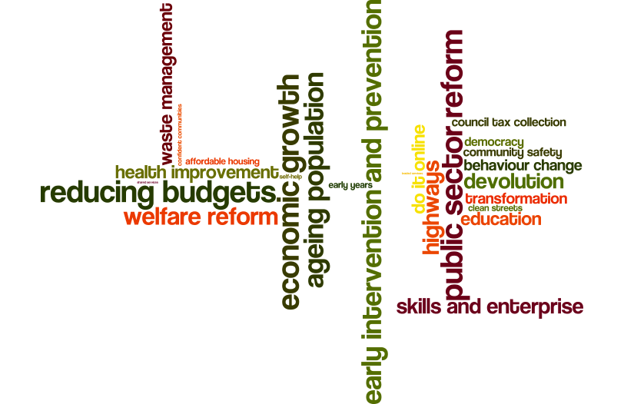
All councils have similar issues…

Slide 3

And similar ways of measuring them…
Service performance
Financial (value for money)
High level KPIs
So, what difference does being a co-operative council make?

Slide 4


Slide 5




The ripple effect ©…
Notes:
As councils we all have issues with which we need to deal. For most issues there is now a set of indicators and measures (the majority of which are quantitative) that will tell us whether the solution / service we have in place is working. In the main we share these indicators and measures with our fellow authorities and this won’t change. For one thing, we need to be able to benchmark against other councils and for another there will always be a need to know whether something is performing well and is providing value for money.
As a co-operative council, we are set apart by how we go about getting the desired result and maximising the social, physical and emotional value added that can be gained from each one – the ripple effect.
So, the ripple of effect of removing barriers to higher skilled employment has a ripple effect on the employee and the ability they have to provide for their families and their chances for the future; the employer solves a labour issue, sees the borough as a good place to do business, uses local supply chains, creates a strong local economy; public services see an increase in the level of trust and goodwill from businesses in the borough which means better relationships leading to increased partnership working with the private sector.

Slide 6
What does that mean?
Issue X
Indicator X
Co-operative difference of the solution:
Ripple effects:
X
Y
Z
Shared issue across a number of councils
Agreed measures / indicators of progress in this area
What is co-operative about the solution?
Place impact: Better networks, increased resilience, stronger communities, sustainable change
People impact: Increased resilience, confidence and self-worth, better opportunities for change
Public services impact: Reducing dependency, changed relationship with communities
Notes:
What is co-operative about the solution?
Based on our values
Based on our behaviours
Based on collective benefit
Ripple effects:
Place: Not all existing indicators can do this job. New indicators and measures may need to be crafted.
People: Not all the measurement of co-operative impact can be done through indicators. There is a lot of information on impact to be gained from case studies and personal accounts of the difference something has made.
Public Services: This is not just Council. In a co-operative borough, there would be advantage to all public services, third sector and others such as RSLs.

Slide 7
A Co-operative place has…
A strong economy and opportunities for further economic growth
Thriving businesses and enterprising residents
All sectors working towards a joint vision for place
High levels of productivity with everyone doing their bit
Diverse and cohesive communities benefiting from equal opportunities

Slide 8
Co-operative people who are…
Confident and resilient, willing to work with other residents and public services
Skilled, productive, employable and healthy
Able to find solutions for themselves, their families and communities
Involved in their communities, happy to help others
Proud of where they live and their identity

Slide 9
Co-operative public services which…
Have a shared, and asset based, understanding of people and places
Collaborate effectively to develop both people and place based solutions – a coop deal
Pool assets and resources to tackle challenges
Find new and effective ways of working with residents and other stakeholders
Focus on delivering shared outcomes and maximising social value

Slide 10
Example 1: Working Xtra
Issue: Low levels of employment and participation
Key indicators: ● Unemployment levels ● Participation in volunteering
Co-operative solution:
A borough-wide housing allocations policy that rewards households who do their bit through working, taking part in work-related training scheme, volunteering or caring for a household member. Residents engaged in these activities can apply for wide range of homes for rent which are allocated to those who qualify under this initiative (at least 50% of new affordable housing / 15% of re-lets)

Slide 11
Ripple: Working Xtra
Place: ● More stable communities ● Less ASB and crime ● Stronger economy (lower unemployment) ● Increase in satisfaction with area as a place to live
People: ● More resilient (financially and emotionally) ● Increase confidence levels ● Healthier people (quality housing) ● Increase chance of future employment (skills and experience)
Public Services: ● Strong partnership working ● Increase in resident satisfaction (reputation) ● Reduction in demand ● Changing social norms

Slide 12
Example: Council Tax Collection
Issue: Low Council Tax Collection rates (particularly relating to those eligible for the Council Tax Reduction Scheme)
Indicators: ● Council Tax Collection rate
Co-operative solution:
Bad debt, poor budgeting and deprivation are some of the underlying reasons why some people don’t pay their Council Tax. Those who don’t pay usually enter into a process whereby a court summons is issued. There are a number of things that a Co-operative Council can do if residents let us know they are struggling to pay e.g. provide personal budgeting support and welfare advice, offer flexible payment methods, help with access to fair finance (i.e. Credit Union)

Slide 13
Ripple: Council Tax Collection
Place: ● Feels more equitable ● Stronger economy (increased incomes spent locally)
People: ● Increase in financial resilience (increased household income, access to fair finance and ability to budget) ● Improved wellbeing (mentally and emotionally)
Public Services: ● Increased collection levels (Reduced budget pressure) ● Better relationship with residents ● Changing social norms

Slide 14
Public
Services
People
Long-term
Place
Medium-term
Short-term
Immediate
Co-operative solution
Specific KPIs (T3) continue to test impact – plus case studies to take co-op difference
Specific KPIs to test impact – unlikely to see co-op difference immediately
Medium-term: KPIs (T2) : plus case studies and links across to other co-op solutions
High level: KPIs: Economy, satisfaction, demand reduction

Slide 15
Next steps
The next steps in terms of publishing the framework are as follows:
Send the co-operative ideal outlines out to members to refine and agree (end of Nov 2016).
Identify two or three CCIN Member Councils who will pilot the methodology on live examples of co-operative solutions that are either in development or in implementation (Nov 2016).
Working group to consider the feedback on the ideals, finalise the high level KPIs for each one, and use the outcome of the pilots to inform the final publication (January 2017).

Slide 16
You can get started straight away…
Today you have the opportunity to:
Input to the outlines of the co-operative ideal for place, people and public service
Consider some of the top level KPIs that would reflect the ideals
Share with us some of the ways in which you measure the co-operative difference you are making
We will be in the exhibition hall later and happy to chat!

