Slide 1

Culture School by Rania Vamvaka

Slide 2
1.How I came up with the idea 2.What is Culture School 3.Why Culture School

Slide 3
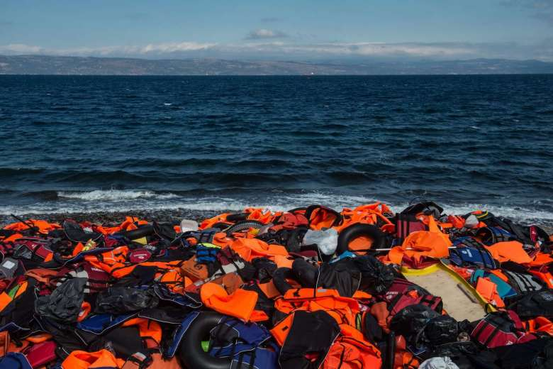
How I came up with the idea

Slide 4
What is Culture School
Week 1
https://www.youtube.com/watch?v=UqueZE2_Krk&feature=em-share_video_user
Week 2
https://www.youtube.com/watch?v=e6mdsboDOdc&feature=em-share_video_user
Week 3
https://www.youtube.com/watch?v=U5pBaLh56PU&feature=em-share_video_user
Week 4
https://www.youtube.com/watch?v=V7bujlFnvMg&feature=em-share_video_user

Slide 5
Why Culture School
https://www.youtube.com/watch?v=ZS8Tlti9LHU&feature=em-share_video_user

Slide 6
Thank you!
@RaniaVmk

