Slide 1
Being a Cooperative Council
Abigail Melville, RSA

Slide 2
Familiar context
Less money
+ deep rooted, socially determined issues
+ traditional public service delivery
= failure and decline
OR a radically different approach

Slide 3

New paradigm
Tony Blair (1997) “Delivery, delivery, delivery”
Now:
“You can’t deliver outcomes
like delivering a parcel.”
Outcomes are always co-produced.

Slide 4
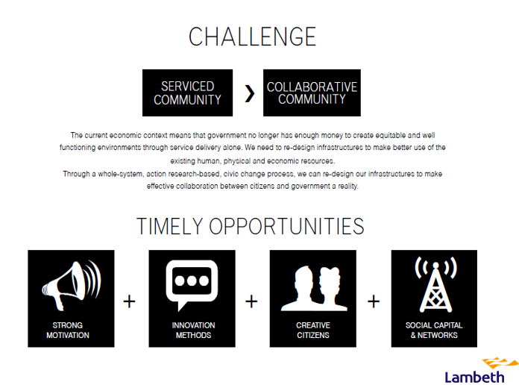

Slide 5
CCIN
Special Interest Group of the LGA
Two years old
23 Councils, UK wide
Chair, Andrew Burns, Leader of Edinburgh

Slide 6
Activity
Policy development and influencing
Events and conferences
Information, news and networking
Collaboration and learning
www.coopinnovation.co.uk

Slide 7
Cooperative Councils Values and Principles
Social partnership
Democratic engagement
Co-production
Enterprise and social economy
Maximising social value
Community leadership and a new role for councillors
New models of meeting priority needs
Innovation
Learning

Slide 8
CCIN vision and theory of change
How Cooperative Councils create productive places and resilient communities

Slide 9
A Cooperative Place is
Fair – we tackle deprivation and ensure opportunities for all.
Responsible – we promote self reliance and mutual aid so everyone does their bit.
Collaborative – we develop honest relationships, building on the strengths in our community to achieve shared outcomes.
Democratic – we grow involvement and earn the right to lead by building trust. We make listening to our community part of everyone’s day job so every citizen feels they can have an influence. We share information and power so people can take control.

Slide 10
Council so what?
Place so what?
..difference for People
Leading cooperation to promote social and economic wellbeing
Good growth – an economy that benefits all
A thriving place where people want to live
Productivity - enterprise, innovation and networks
People are resilient, confident and skilled
Building on strengths and assets (not deficits or needs)
Responsibility – everyone doing their bit
There is choice and opportunity for all
Connecting – creating space and conversations for change to happen
Connectivity – despite austerity, working with others to make a difference
Power, responsibility and benefits are shared
Involving stakeholders in every decision
Democracy – everyone has a say in what happens and future of this place
People make a contribution
Building trust by being honest, open and transparent
People trust each other and local institutions
Shared priorities for economic and social value
Community Dividend – put something in, get something out
Sharing power and responsibility, including changing the Constitution
New forms of Shareholder Governance
THEORY OF CHANGE
How do we need to work differently?
What impact will it make?

Slide 11
Different role for the council and for councillors
Leader
Broker
Connector
NOT - delivery organisation, decision-maker, expert/owner of information

Slide 12

CHALLENGE – New skills set

Slide 13
Benefits of cooperative working
Reduce costs
Improve information
Greater impact
Improved design of solutions
Improved delivery
Improved reach
Learning and innovation
Community/individual empowerment
Shared Values

Slide 14
What do Coop Councils do differently?

Slide 15
Five aspects
Community need
Behaviour change
Assets
Co-production
Cooperative commissioning

Slide 16

Cooperative solutions to meet community need
Cooperative Energy Companies
Financial Inclusion and Credit Unions
Enterprise Trusts
Growing the social enterprise sector

Slide 17

Behaviour change – everyone doing their bit
Social responsibility campaigns (from community clean up to domestic violence)
Living wage campaigns
Community benefits approach
Plymouth 1000 Club

Slide 18

Use of assets
Driving social value from new commercial development
Building on strengths – revitalising markets
Underused space to stimulate growth – Brixton Village
Co-operative development - Brixton Green
Sharing public assets
Community asset transfers

Slide 19

Co-production – power shift
Lambeth Youth Co-op – young people commissioning all youth services
Parks, Leisure Centres, Libraries
Social Care
Housing
Employment

Slide 20

Putting cooperative values at heart of council business
Whole organisational change
Commissioning, culture and councillors - Lambeth
Values driven, innovative and pragmatic - Oldham

Slide 21
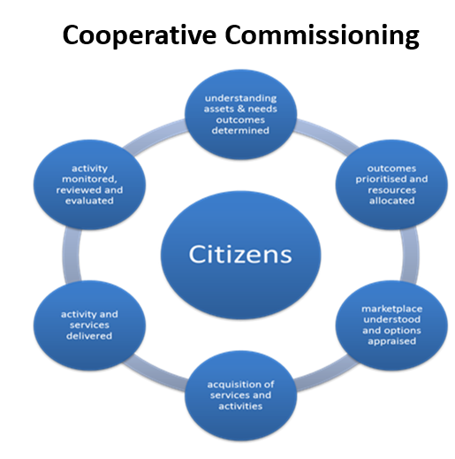

Slide 22
Very different route maps….common factors
Build Trust, council on side of people – pick issues, raise profile
Grow local eco-system - hand over assets, build capacity, foster innovation, collaborate, support, publicise
Look for win-wins – build on strengths, capture commitment, commission small organisations
Find and use leverage – buying power, consumer power, reputation, simple call to action
Bring people together – develop connector role

Slide 23
Major Challenges
Culture - internally
Relationships – externally
Trust, and engagement, with citizens

