Slide 1
CCIN Policy Commission on Community Resilience, Jobs and Growth
Sandwell Evidence Session
27 November 2014

Slide 2
Our aims for today
Share evidence of cooperative practice and the difference cooperation makes
Develop ideas for a better system – a cooperative “offer”

Slide 3
CCIN’s Policy Commission

Slide 4
Key question:
How can a cooperative approach help local economies work better, tackle labour market exclusion and support economic growth?

Slide 5
Aims
To gather compelling evidence to influence the debate in favour of a locally-led cooperative approach to jobs, growth and welfare.

Slide 6
People
Working group of Leaders and Officers from CCIN Councils
Chaired by Cllr Lib Peck, Leader of Lambeth
RSA secretariat

Slide 7
Approach
Call for Evidence – deadline 28th Nov
Evidence Sessions in Liverpool, Sandwell and Plymouth
Meetings with policy-makers and national stakeholders
Working Group reviews findings and shapes recommendations
Final report - mid February

Slide 8
Collecting three types of evidence
Perceptions of people involved
Notes:
Perceptions about how the system works now and how it could work better, based on personal experience
Case study examples of projects and initiatives which describe the difference local cooperative working can make
Quantified evidence, data, evaluations or reports which help demonstrate the value of cooperative approaches

Slide 9
Case study examples which describe cooperative initiatives
Notes:
Perceptions about how the system works now and how it could work better, based on personal experience
Case study examples of projects and initiatives which describe the difference local cooperative working can make
Quantified evidence, data, evaluations or reports which help demonstrate the value of cooperative approaches

Slide 10
Quantified evidence – data and reports
Notes:
Perceptions about how the system works now and how it could work better, based on personal experience
Case study examples of projects and initiatives which describe the difference local cooperative working can make
Quantified evidence, data, evaluations or reports which help demonstrate the value of cooperative approaches

Slide 11
Final Report
The case for a local cooperative approach
Design principles for a better system
Recommendations for national and regional policy

Slide 12
What do we know already?

Slide 13
The system is complicated
NESTA, 2012

Slide 14
Public money not used effectively
“We spend £5 billion per year and yet the system is not working effectively in connecting individuals to work” (NESTA, 2012)

Slide 15
Collaboration with employers is weak
“We need a step-change in the way public services – such as schools, colleges, and employment and training providers – collectively respond to the needs of employers across a place” (LGA, 2013)

Slide 16
* By “the system” we mean organisations that engage in bringing non-working adults into work.
What system?
Notes:
System is most complicated at the lower skilled/paid end of the labour market. Things are simpler at the top!

Slide 17
TASK On your tables – 7 minutes
Introduce yourselves
Suggest one issue or barrier in the current system
Suggest one thing that is working well
Try to come up with different ones!

Slide 18
Create two flipcharts about the current system
Blockers and barriers
Things we want to keep
Keep adding to these throughout the day

Slide 19
What is a co-operative approach?

Slide 21
A Cooperative Place is
Fair – we tackle deprivation and ensure opportunities for all.
Responsible – we promote self reliance and mutual aid so everyone does their bit.
Collaborative – we develop honest relationships, building on the strengths in our community to achieve shared outcomes.
Democratic – we grow involvement and earn the right to lead by building trust. We make listening to our community part of everyone’s day job so every citizen feels they can have an influence. We share information and power so people can take control.

Slide 22
Council so what?
Place so what?
..difference for People
Leading cooperation to promote social and economic wellbeing
Good growth – an economy that benefits all
A thriving place where people want to live
Productivity - enterprise, innovation and networks
People are resilient, confident and skilled
Building on strengths and assets (not deficits or needs)
Responsibility – everyone doing their bit
There is choice and opportunity for all
Connecting – creating space and conversations for change to happen
Connectivity – despite austerity, working with others to make a difference
Power, responsibility and benefits are shared
Involving stakeholders in every decision
Democracy – everyone has a say in what happens and future of this place
People make a contribution
Building trust by being honest, open and transparent
People trust each other and local institutions
Shared priorities between all key players
Sharing power and responsibility, including changing the Constitution
Community Dividend – put something in, get something out
New forms of Shareholder Governance
THEORY OF CHANGE
How do we need to work differently?
What impact will it make?

Slide 23
Cooperative principles
Social partnership between public, commercial and community sectors, based on shared responsibility and mutual benefit
Co-production: citizens are partners in designing, commissioning and delivering services
Maximise social value by building on the value inherent in local assets and local networks

Slide 24
Examples of cooperative principles in practice
Social partnership – organisations shared resources, management, accountability
Collaboration to developing understanding eg Fairness Commission; sharing evidence of skills shortages
Joint investment by organisations from different sectors
Joint management (and accountability) by two or more partner organisations.
Cooperative management - accountability sits with a co-operative (i.e. owned by its staff and/or members), mutual or social enterprise so as to generate social returns alongside financial returns (e.g. Knowsley Youth Mutual).

Slide 25
Rule of thumb – is there collaboration?
Citizens (Job seekers)
Business (Employers)
Public sector (Providers)

Slide 26
Examples of cooperative principles in practice
Co production - professionals and citizens share power to design, plan and deliver together
- Interventions are co-designed by people who are intended to benefit (e.g. personal budgets for training and qualifications).
- Interventions are co-delivered (e.g. volunteers and mentors are drawn from the service user community).
- Collaborative commissioning and procurement (e.g. using procurement to support local supply chains; aligning S106 obligations to skills shortages)

Slide 27
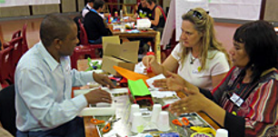
Rule of thumb – do citizens have power to make decisions?

Slide 28
Examples of cooperative principles in practice
Maximising social value from assets and networks
- Interventions designed to build on the unrealised value in locally-situated social connections, networks and relationships (e.g. Backr).
- Interventions broaden access to under-utilised physical assets in the locality securing long-term benefits to locally-owned businesses and local residents (e.g. information which fosters stronger connections between local food growers and market traders).

Slide 29
Rule of thumb – are we building on what we’ve got and making connections?

Slide 30
Evidence of cooperative practice
Can come from anywhere
Any sector - doesn’t have to be public or social
Any area - doesn’t have to be cooperative council
Test - does the initiative demonstrate cooperative principles?

Slide 31
TASK On your tables – 10 minutes
What are the benefits of working cooperatively?
for individuals
for public/delivery organisations
for business
for the tax-payer
What are the down-sides?
Notes:
Copies of the task, feedback and 3 slides headed “examples of cooperative principles in practice” to be on each table for reference

Slide 32
What difference does co-operation make?

Slide 33
What benefits can we measure?
For example,
lower cost
better quality
increased take up and use
more sustainable
wider community impact – for example on health and well being?

Slide 34
What other benefits can we identify?
to systems and relationships
to feelings and identity
to confidence and trust

Slide 35
TASK Specific benefits of cooperative approaches
Come up with examples of cooperative initiatives, projects or programmes? Explain how they are cooperative using the three criteria.
What specific benefits can you identify from these examples? What is the evidence to support these claims? How convincing are they?
Notes:
Copies of task questions and guidance on each table

Slide 36
Produce a flipchart to feedback
Name of initiative and cooperative principle | Summary of benefits | Contact for more information
Eg Social Partnership,
Co-production,
Building on assets
Eg Cost, quality, take-up/reach, sustainability, wider community benefits

Slide 37
Designing an alternative system

Slide 38
Key question:
How can a cooperative approach help local economies work better, tackle labour market exclusion and support economic growth?

Slide 39
Key question:
How can a cooperative approach help local economies work better, tackle labour market exclusion and support economic growth?
An “employment” system that benefits all

Slide 40
What does success look like?
businesses and citizens feel they have a stake in the success of the place and its wider competitive advantage
strong local networks help businesses and providers collaborate and learn from one another
local institutions give power and voice to local people, ensuring that support is well designed and networks are inclusive to different groups

Slide 41
How does it work for the most excluded?

Slide 42
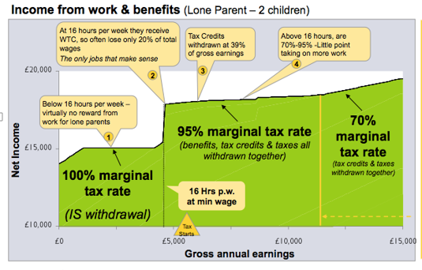

Slide 43
What are the barriers to work – and who owns them?
Notes:
EG. Who is responsible for developing (the right) skills?

Slide 44
What do employers need?
appropriate skills?
attitudes and behaviours?
public sector to get out of their way?
Could “council as connector” role create business advantage?

Slide 45
IMAGINE A DIFFERENT WORLD
What would a better approach look like?

Slide 46
LOSE YOUR PROFESSIONAL HAT

Slide 47
Possible design principles
Social partnership and shared responsibility – eg the German model
Pathways for individuals –analogy of a clinical care pathway - with co-production of outcomes
Innovation and learning
Devolved budgets (skills, employment, and possibly welfare) with local accountability for social and economic impact
Notes:
Social Partnership can be defined as a tri or multi-partite arrangement involving employers,
trade unions, public authorities (the state and/or local/regional authorities) and/or others
(e.g. voluntary sector). Social partnership is usually concerned with areas of economic and
social policy and might be based on a binding agreement or declaration of intent. (The
Copenhagen Centre for Partnership Studies, 2002).
'Social partnership' in Germany is shorthand for the consensual system of labour capital
relations which developed in the 1950s. The economic success and low incidence of
industrial conflict that have until recently characterised post-war Germany are commonly
attributed to Social Partnership.

Slide 48
TASK: Design a system (1) to reduce labour market exclusion and increase labour market participation.
Issues to consider:
skills, confidence, information, employability of unemployed, under-employed and economically inactive
role of job seekers
role of employers
role of brokers

Slide 49
1. PEOPLE
into work

Slide 50
TASK: Design a system (2) to increase the scale and reach of employment opportunities.
Issues to consider:
- Number and accessibility of jobs and their quality
- Information/knowledge about job opportunities and skills requirements
- Role of employers
- Role of job-seekers
- Role of brokers/intermediaries

Slide 51
2. JOBS -
more and better

Slide 52
TASK: Design a system (3) to increase business activity, and the sustainability and growth of enterprise.
Issues to consider:
- Support for existing business
- Helping individuals start and prosper from their own businesses
- Role of business
- Roles for councils
- Roles for citizens

Slide 53
3. BUSINESS – growth, enterprise, sustainability

Slide 54
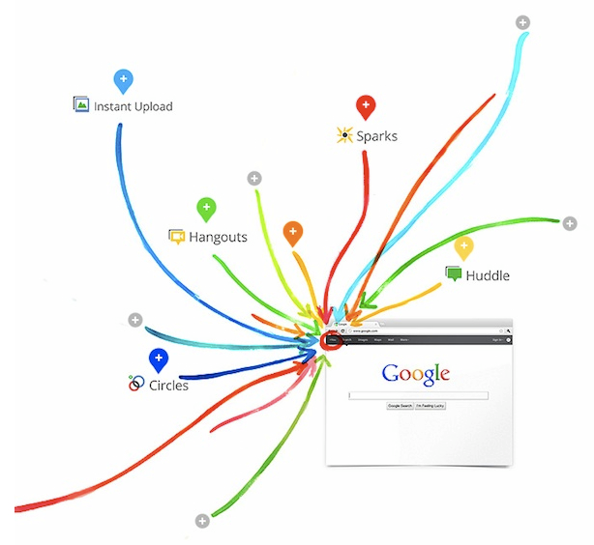
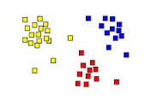

Slide 55
Feedback your ideas – visually!

Slide 57
Examples

Slide 59
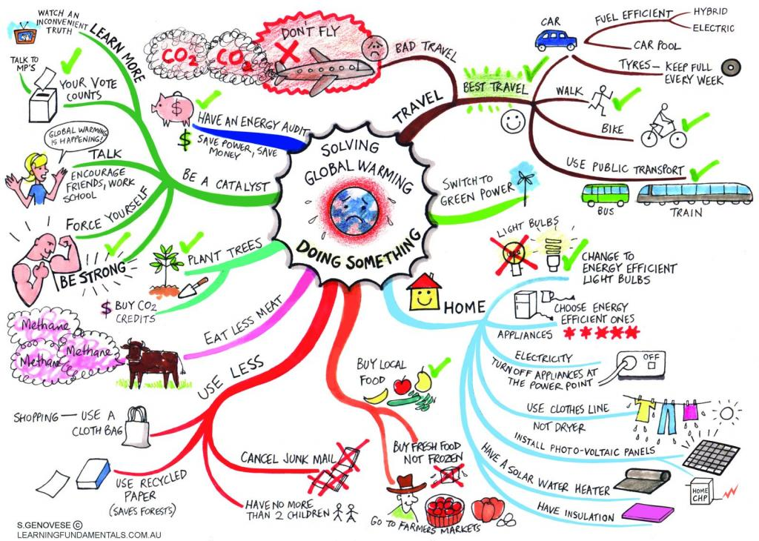

Slide 60
A better system - feedback

Slide 61
THANKYOU
Send us your evidence!!
See our call for evidence at:
coopinnovation.co.uk

