Slide 1
Co-Production, Personalisation
& The Lambeth Living Well Collaborative
Karen Clarke
Integrated Mental Health Commissioning Team

Slide 2

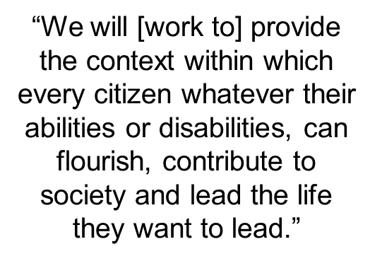
Our story starts with wanting to radically improve outcomes within a context of reduced public expenditure

Slide 3
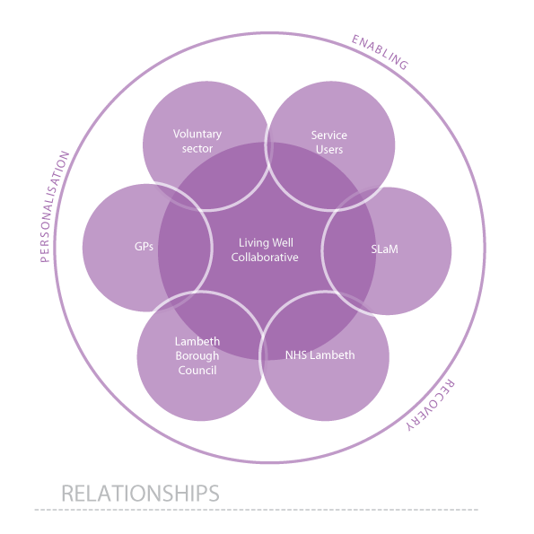
The Partnership Platform

Slide 5
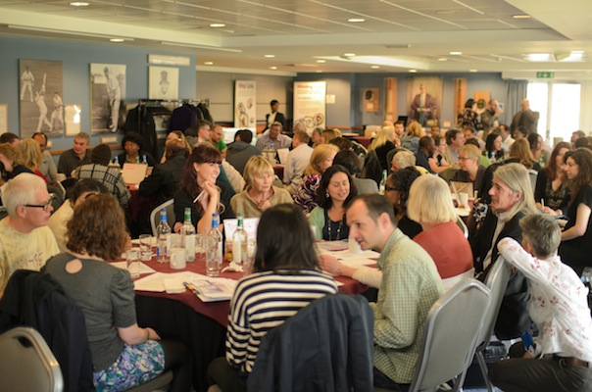
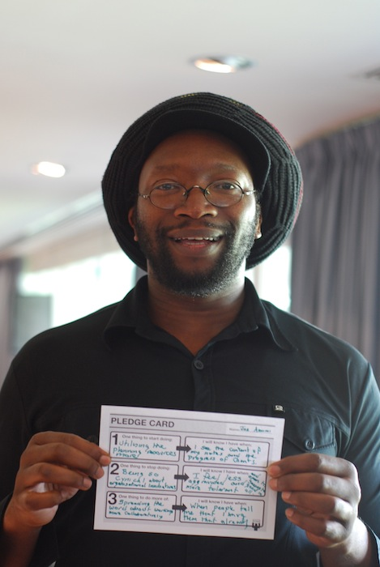
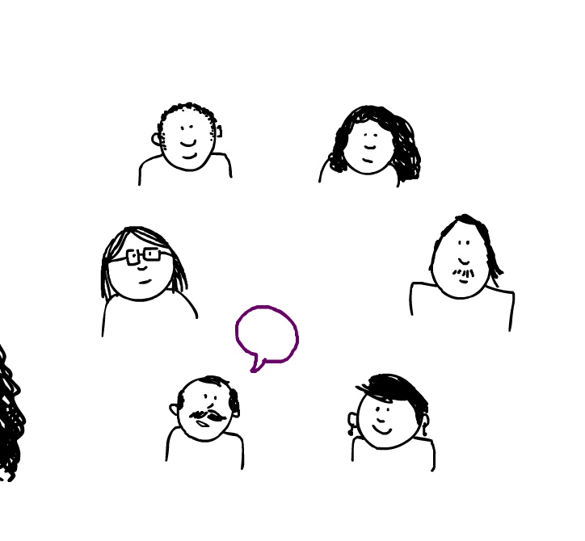
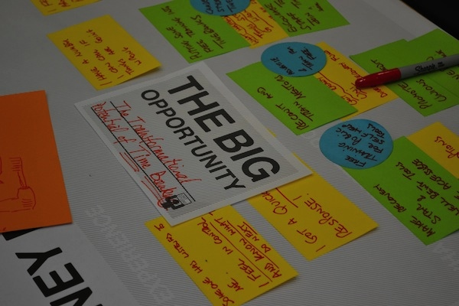
We have to work with people to design and make decisions about what support we all want to see

Slide 6
Working with people differently
People as citizens and partners in delivery of their care
Integrated care and support across health and social care
Improved access
Better guidance and support in the community
Primary care capacity
Peer support
Increased user control and choice
Getting connected and supporting reciprocity

Slide 7
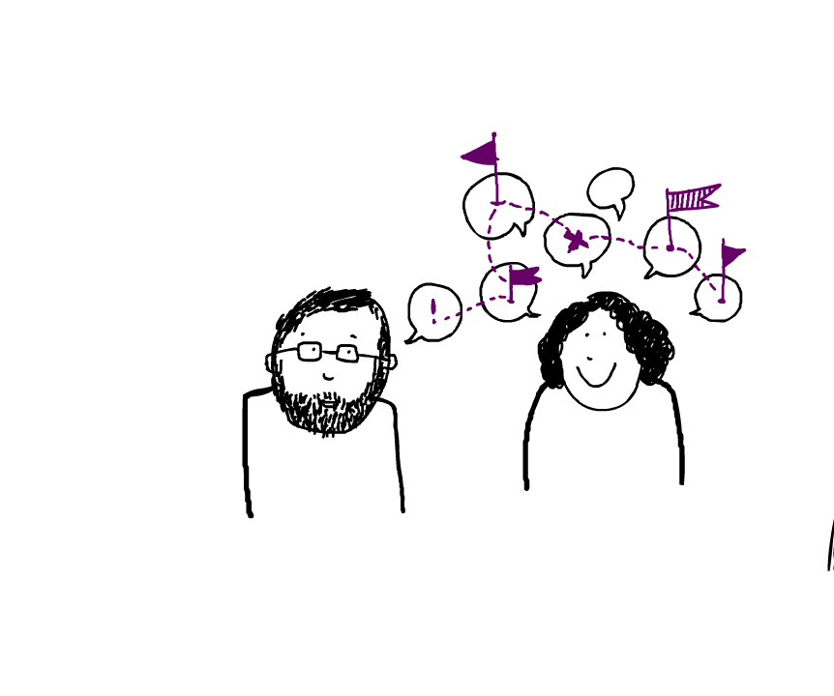
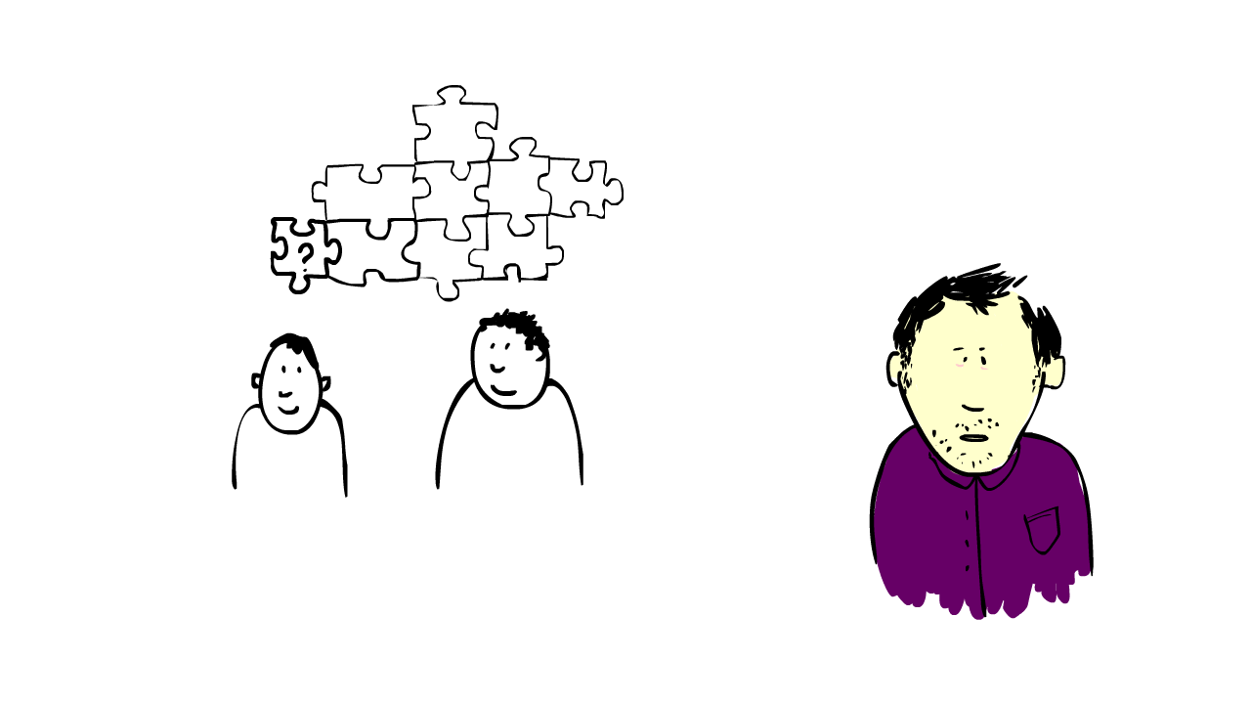

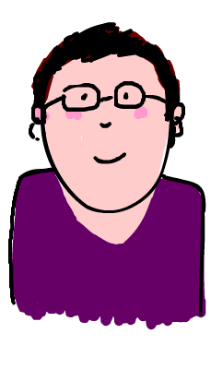
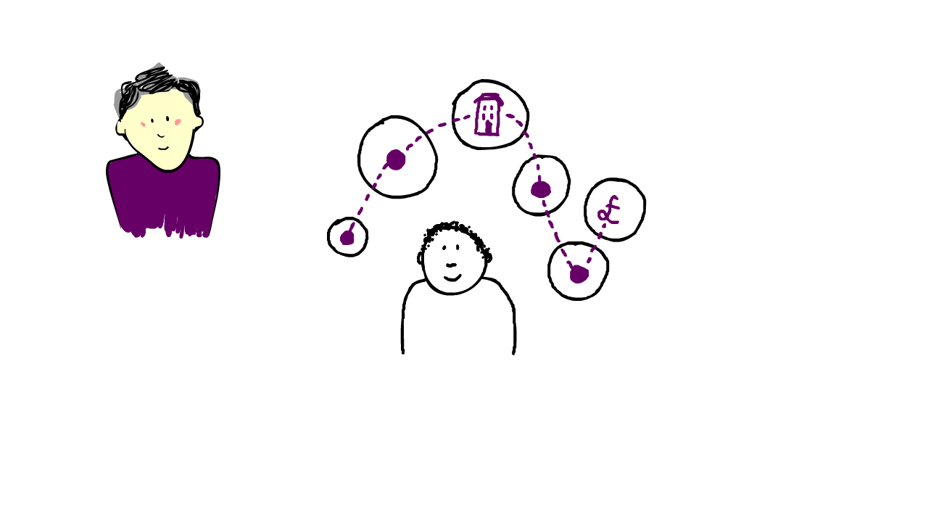
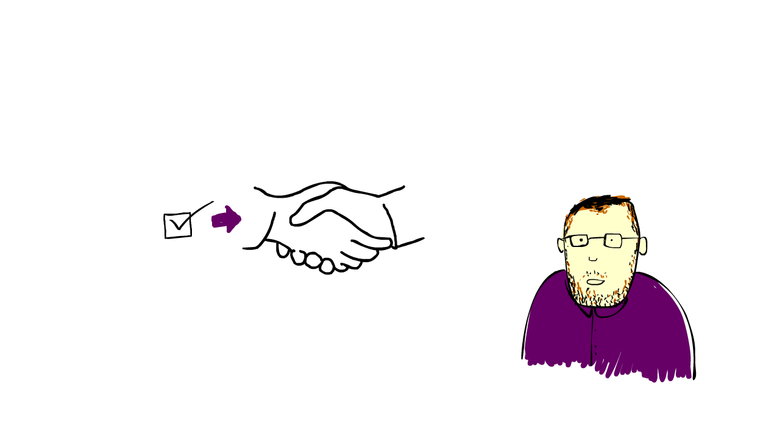
Making people’s
assets work
Scaling
peer support
Bringing together specialist and community support effectively
Specialist
Building community assets
Working together differently and timebanking

Slide 8
What we’ve been doing
Making people’s assets work: Community Options Team, recovery & support plan
Working together differently:
Personal health budgets & integrated health and social care budgets, time banking
Building community assets:
Mapping local assets, community connectors
Improving advice and information:
Living Well Partnership

Slide 9
What we’ve been doing
Scaling-up peer support:
Missing Link, Solidarity In A Crisis
Developing new service models:
Community medication prototype, core/flexi housing schemes
Growing culture change:
  Training for sector teams, collecting stories and developing the Collaborative website

Slide 10
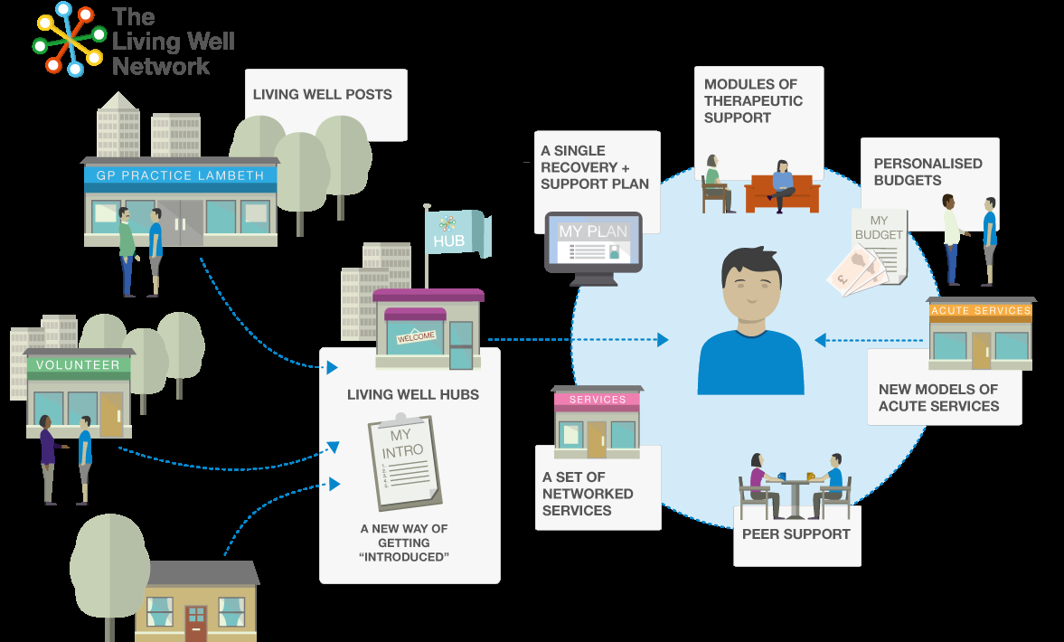
A Network Approach

Slide 11
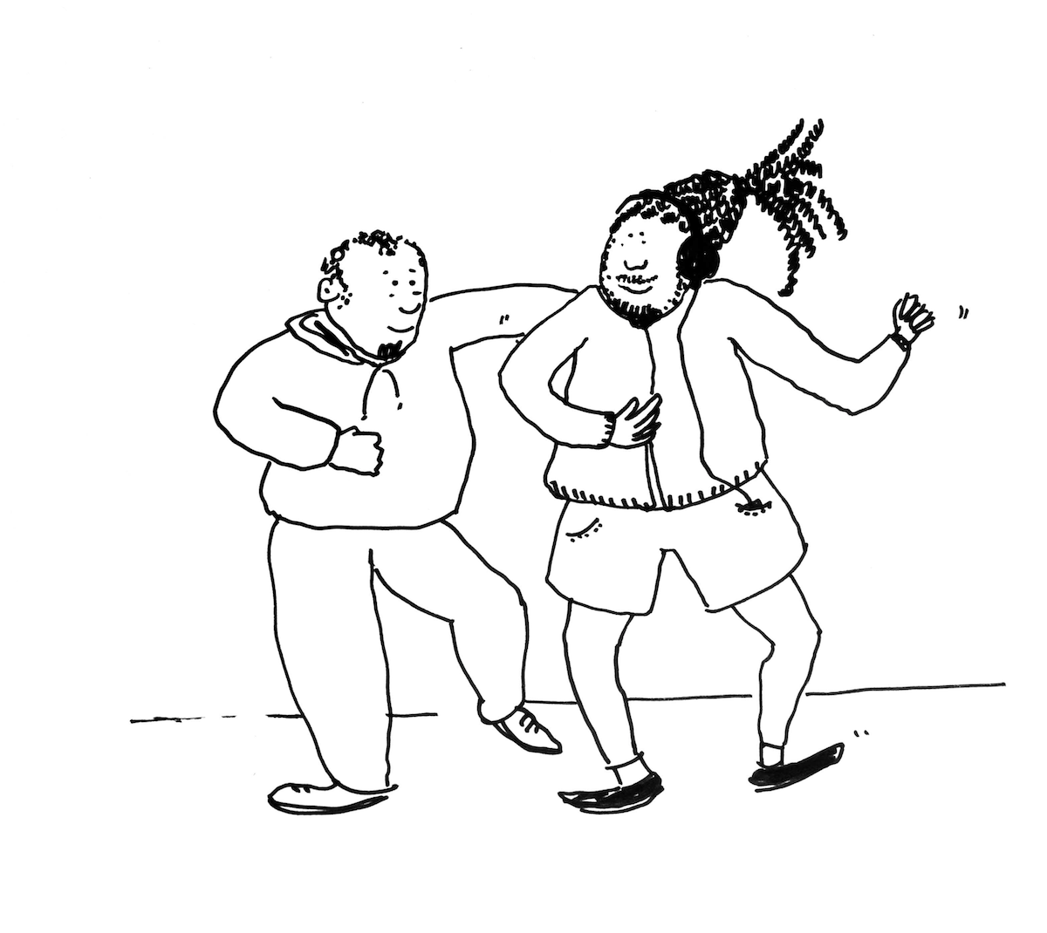
The Living Well Network Hub
Turning the system on its head, improved access and holistic triage at the ‘front end’
Working with people differently
Moving from a crisis-focused system to one that is focused on early intervention and reablement
‘ Easy in and easy out’ between Primary
and Secondary care services
Community Incentive Scheme for GPs

Slide 12
Provider Alliance Group
The PAG are the operational arm of the Collaborative
They bring life and structure to the re-shaping of Lambeth’s mental health services
Comprising providers including South London and Maudsley Trust (SLaM), commissioners, Lambeth Head of Social Care for mental health, service user representation

Slide 13
Our New Commissioning Model

Slide 14
Alliance contracting
Collaborative contracting through an Alliance Group
Improved, integrated service offer at a reduced cost to the system
Outcomes-based contract encouraging alignment of values and behaviours
Gainshare and painshare for providers and commissioners

Slide 15

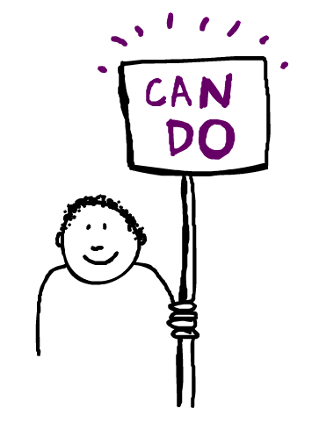
www.lambethcollaborative.org.uk

