Slide 1
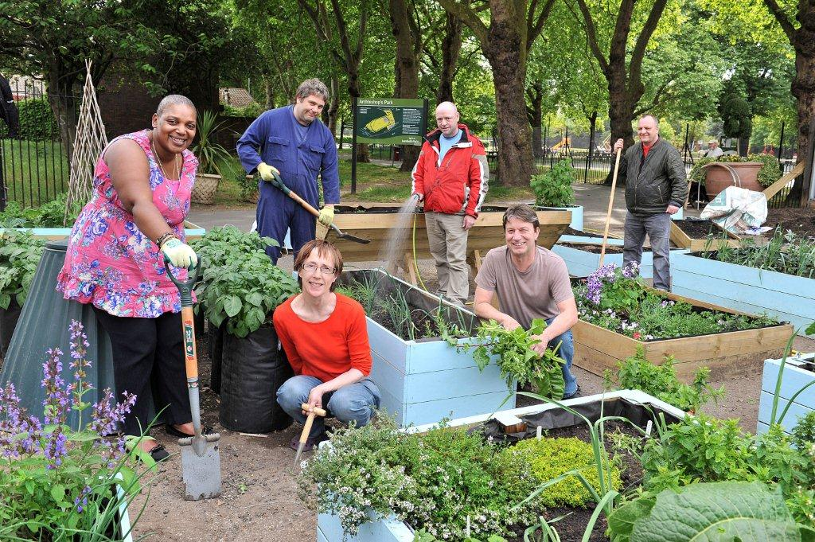
Lambeth Cooperative Parks Programme
Notes:
Friends of Archbishops Park

Slide 2
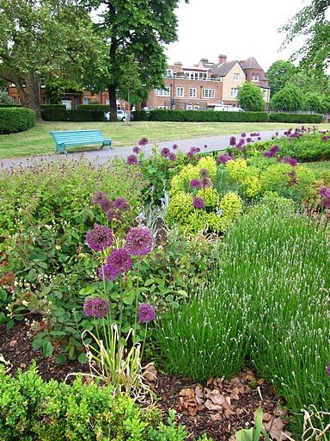
The Facts
Parks offer excellent social return on investment
60 parks and open spaces
Over 33 active friends of parks and community groups
Cuts in central government funding mean a different landscape for parks
There is local interest in decision-making about parks

Slide 3
Transformation Process
Management Model Proposals
Council-led Management
Council-led Management
Borough-Wide Public Consultation
Took place from July – October 2013
Approval
20 pioneering groups came forward
Cooperative Management
Determine local appetite for programme
89% support greater community involvement
Over 1,400 responses
Public meetings, focus groups, events in parks

Slide 4
Emerging Qualitative Themes
Smaller Parks
Lack of income generation potential
Knowledge and expertise
Council holds technical expertise
Future Resourcing
Confirmation that funding would continue
Possibility of releasing funding back into the park
Impact of disaggregating budgets by park
Risk of being overlooked
Ensure diverse representation of community groups
Council provides monitoring function
Financial start up support

Slide 5
What Next?
Pioneer Support Programme
Public Interest Test
Devolved Local Management

Slide 6
Examples
Myatt’s Field Park
Streatham Common Cooperative
Have set up a Cooperative – SCCoop
Aim to commission SCCoop to manage the Rookery, Streatham Common and Memorial Gardens
Flexibility to commission on a local level
Independent management
New partnership formed between Friends and a social enterprise
Aim to take over maintenance and deliver social value schemes (e.g. training for long-term unemployed)

Slide 7
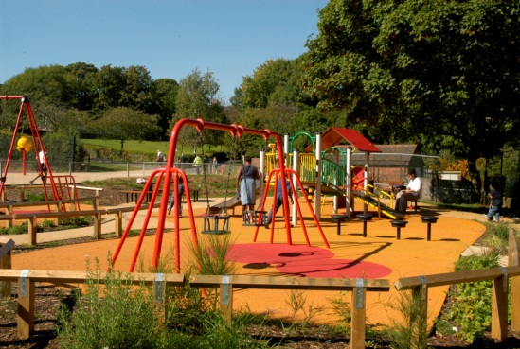
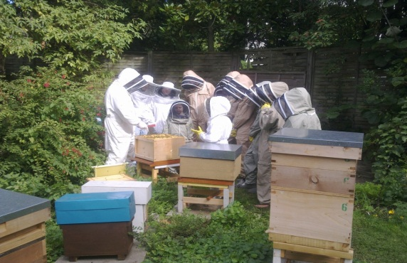
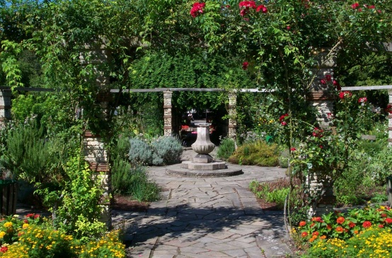
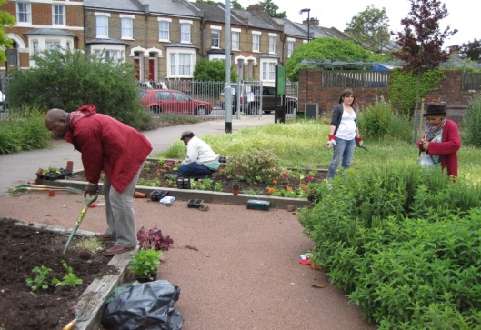
Challenges
Widespread Behaviour Change
  LBL: release control
  Communities: be accountable and take/justify difficult decisions
  Councillors: embedded in new models
Managing Messages
  No hidden agenda
  Not about savings/privatisation
  Communities are our advocates
We don’t have all the Answers
  New and untested model
  Bottom-up approach
  Accept that we’re all learning

Slide 8
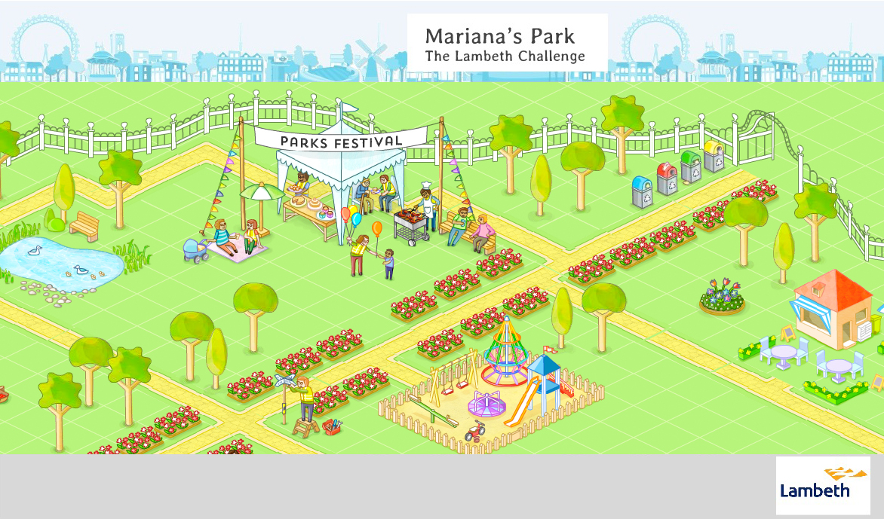
Lambeth Parks Challenge
New interactive tool that allows users to build and run their own virtual park
Aim to educate people on what is involved in managing parks
http://lambeth.parkschallenge.org

Slide 9
Questions?

