Slide 1
Continuing the cooperative journey: cooperative commissioning
Phase 2

Slide 2
What have we learned?
The model – learning from existing projects
Tulse Hill project
Starting with a conversation about the change people want to see
Defining outcomes locally
Working differently with ward councillors
West Norwood Workshop
Practically capacity building in the community and among officers and councillors for community based commissioning
Testing out what local cooperation looks like
Starting by mapping what is there, and what we can build on
Identifying community priorities for change
Cooperative local investment plans
Defined budgets for local areas to be used achieving outcomes
Need to rethink community engagement approach
Key role for ward councillors
Neighbourhood Enhancement Programme
Starting with a conversation about the change people want to see in their area
Focus on building local networks
Recognition that priorities are different in different neighbourhoods
Different role for ward councillors

Slide 3
This is still cooperative commissioning
The model
Understanding assets & needs, outcomes determined
Outcomes prioritised and resources allocated
Marketplace understanding and options appraisal
Acquisition of services and activities
Activity and service delivery
Monitoring and review
CITIZEN
…But not all cooperative commissioning needs to, or should, take place at a borough wide level

Slide 4
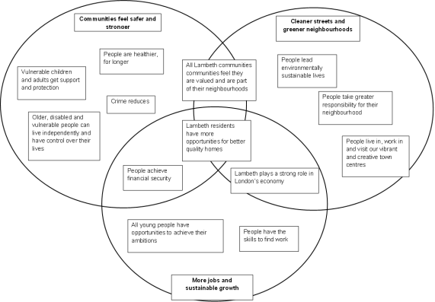
How can it work? Cabinet role
The model – how could it work?
Which outcomes are best commissioned at which level?
Cabinet decides
How do we decide what gets commissioned at what level?
Look at the outcomes at a more granular level and ask:
What is the political aspiration?
What offers the best value for money?
Where do we most need to work closely with people to achieve the outcome?
Where can we build on what is already there?
Allocate resources to each outcome

Slide 5
How can it work? Councillors and citizens
The model – how could it work?
Young people have opportunities to fulfil their ambitions: How can we achieve that outcome here?
Looking at the strengths and needs of our community, we think it would be best to focus on:
* Young people have the skills and attributes that support them to have sustainable careers
*Parents are recognised for playing a strong and positive role in the family and community
Citizens (residents, businesses, groups)
Councillors
Officers
Working together to undertake commissioning
We have these resources (£, people, partners) to achieve this outcome
NB – this example of outcome development is taken from Tulse Hill pilot

Slide 6
We’re still working out:
The model – how could it be delivered?
Cooperation
What are the most (cost) effective ways of working together with people in commissioning and sustaining this over time?
Capacity
What kind of support and development will ward members need to play a leadership role in this?
What kind of support and development do officers need to work more flexibly to support citizens participate in commissioning, including the delivery of outcomes?

Slide 7
And are still working on….
Clarity
How do we address some of the systems issues? What is the best way of allocating resources/ disaggregating budgets?
What issues might arise from operating commissioning at different levels? Too much complexity? Efficiency cost?
Does neighbourhood commissioning automatically lead to more neighbourhood delivery?

Slide 8
Help – where are you at?
What are you doing to work at a local level?
  Do you develop local outcomes?
  Are you doing commissioning locally, or is it neighbourhood management?
What have you learnt?
What is distinctly cooperative about your arrangements?

