Slide 1
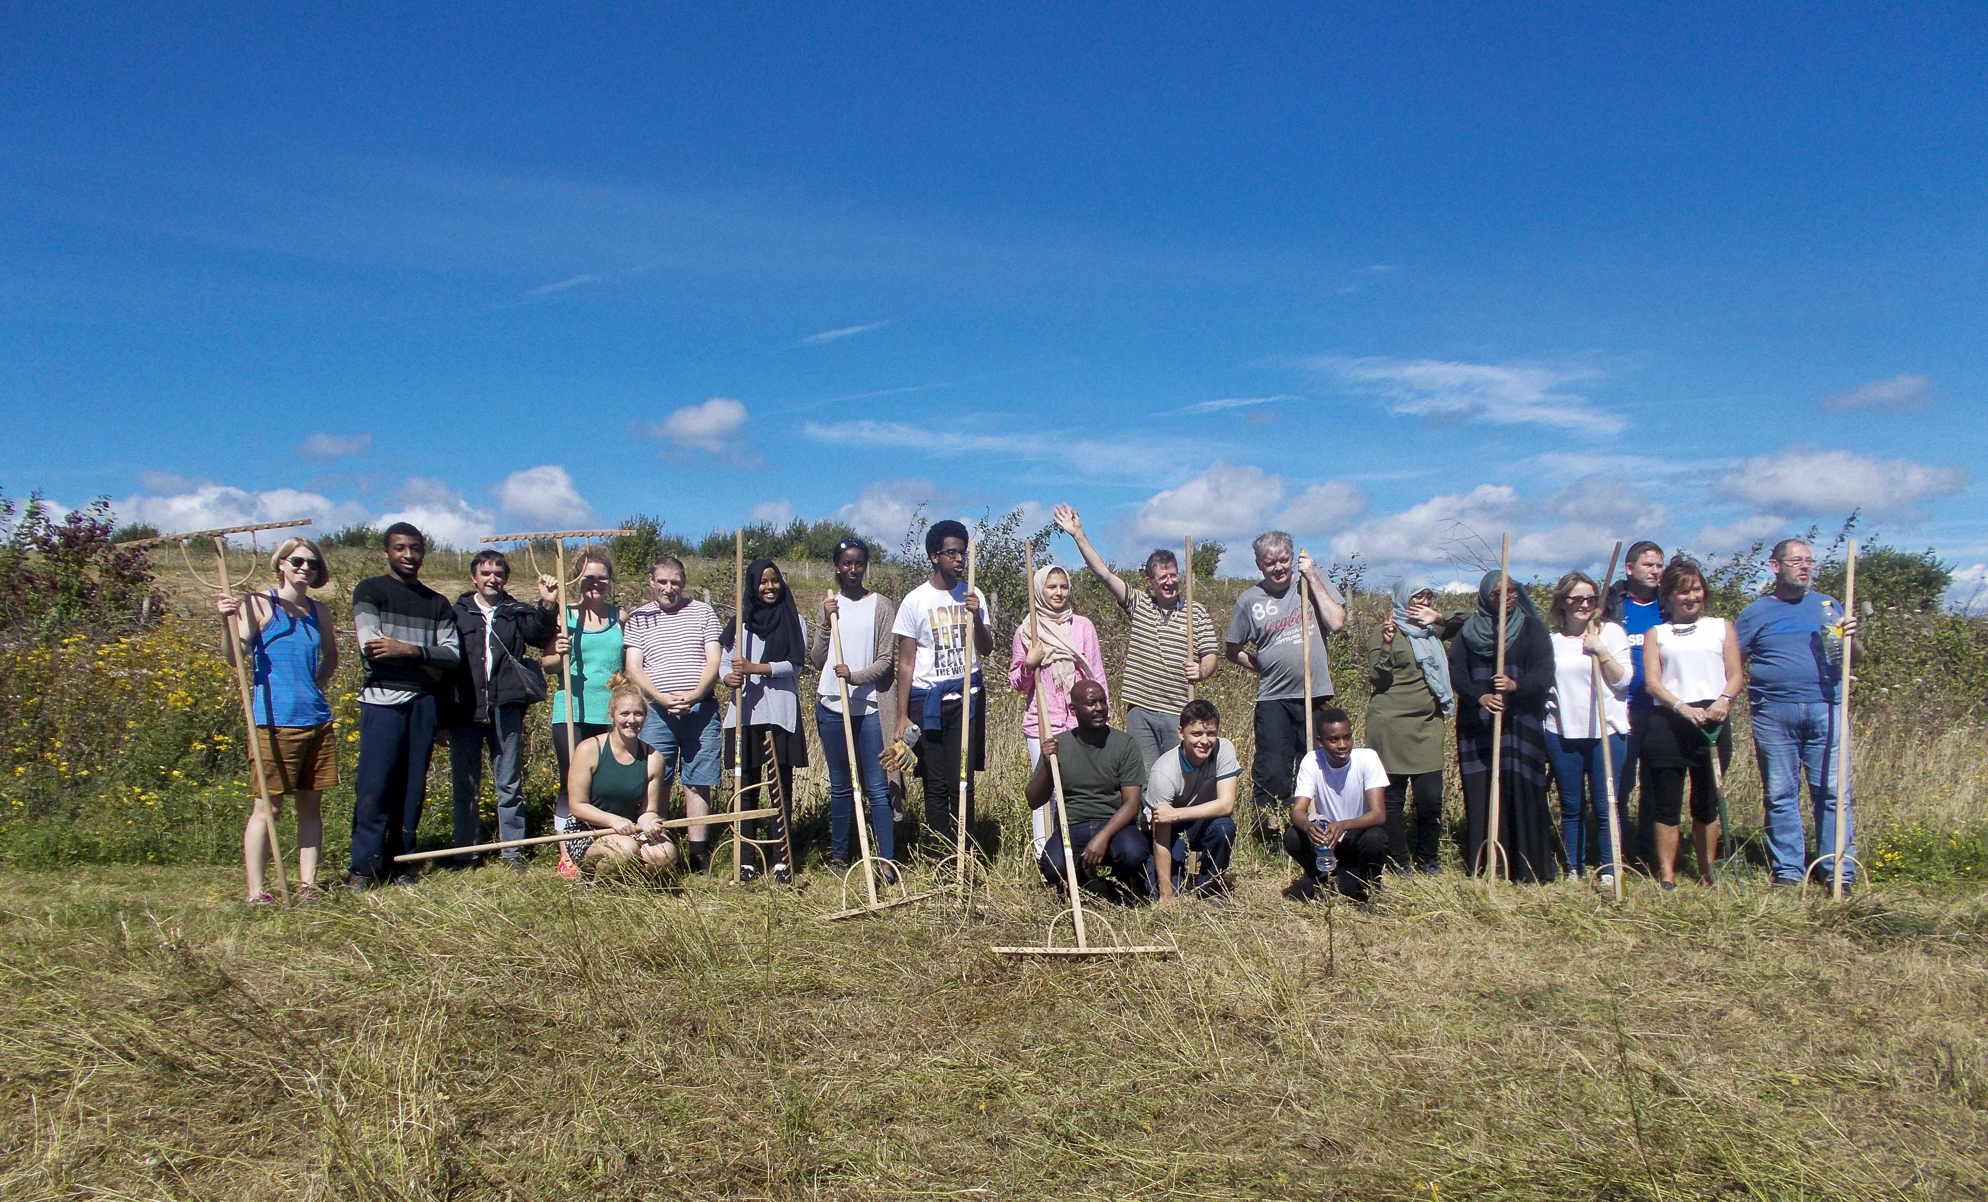
REACH2XL
With backing from the REACH2XL project, young people in Butetown, Riverside and Grangetown are taking an active role in designing the support services they need to help them access and thrive in further education.

Slide 2
REACH2XL
Building partnerships with Cardiff University, Communities First, Cardiff Council, (and Student Volunteering Cardiff, Welsh Government, Innovate Trust, and MentorRing).
Responding to a need for support for young people within these communities (through referrals from community workers, youth workers, teachers and parents).
Working with young people to co-produce effective services (one to one engagement sessions help us to tailor the programme to each young person and identify the guidance they need).
Developing a range of workshops (focusing for example, on personal statements, student finance, time management, and study skills) as well as sourcing appropriate volunteering and work placements.

Slide 3
“Thank you for the opportunities and the time you took out of your time to speak to me. Insha Allah khair we’ll see where the future takes me!” Hafsa, 17
I was really surprised how much I enjoyed the day. I didn’t know what to expect but I was pleasantly surprised at how much I enjoyed it. The people who came from the Innovate Trust and Cardiff University were really nice and friendly… I am looking forward to doing more work like this. I found it really inspirational” Suad, 18
“Thank you very much for the great opportunity – it was great to meet some truly amazing people” Yaseen, 17
Thank you for the opportunity to do the workshop and visit Cardiff University. It was a really good experience and I’m more aware of what I would like to study in university. Thank you” Asia 17
I have had a really good week with a great group of young people who are smart, outgoing and future community role models. I have enjoyed the group discussions and frank talk about options and opportunities including education and job prospects for the future” Saeed, Community Education Officer
REACH2XL

