Slide 1
How Lambeth is becoming a coooperative borough Councillor Lib Peck Leader, London Borough of Lambeth

Slide 2
Lambeth – the operating model Sophia Looney Director, Cooperative Business Development

Slide 3
Whole system change is complex at best…

Slide 4
…fiendish at worst

Slide 5
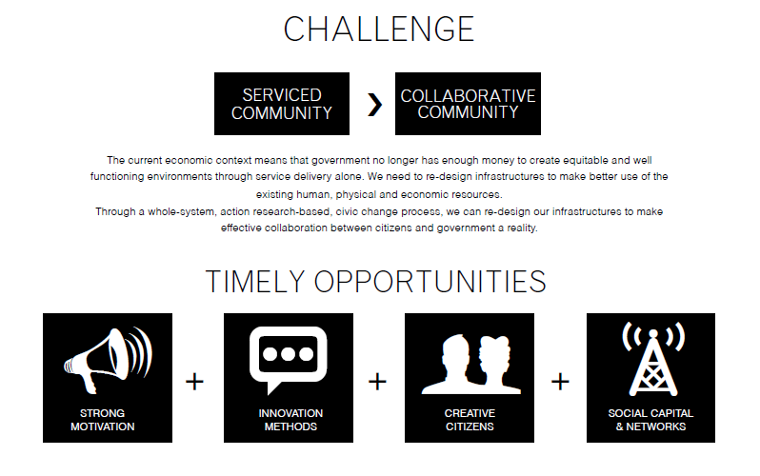

Slide 6
From silos…

Slide 7
…to clusters

Slide 8
Councillors at the centre

Slide 9
Cultural change

Slide 10
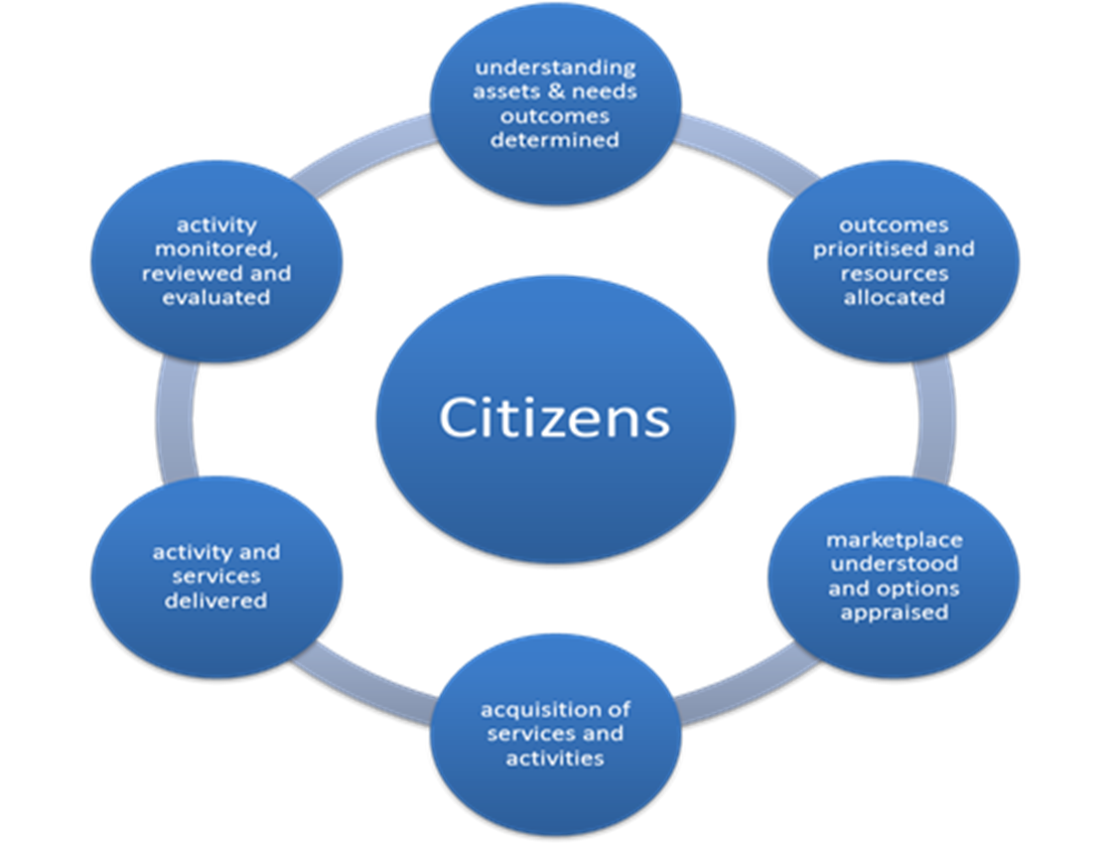
Cooperative Commissioning

Slide 11
Collaborating and building relationships

Slide 12
Making the most of communities’ and workforces’ strengths

Slide 13
TITLE
xxx
Questions?

